Slide 1
Course
Analytics and Big Data
Prof. Dr. Peter Roßbach
SS 2025

Slide 2
Agenda
1 Introduction to Analytics
2 Descriptive Analytics
2.1 Data Warehouse Systems
2.2 Online Analytical Processing (OLAP)
3 Big Data
4 Predictive Analytics
4.1 Subject of Predictive Analytics
4.2 The Analytics Process
4.3 Data Preparation
4.4 Methods, Algorithms and Applications
4.4.1 Classification
4.4.2 Regression

Slide 3
Literature
Data Warehouse / OLAP / Descriptive Analytics:
Vaisman, A.; Zimányi, E. (2016): Data Warehouse Systems: Design and Implementation (Data-Centric Systems and Applications), Springer.
Data Science / Predictive Analytics / Machine Learning:
Alpaydin, E. (2016): Machine Learning: The New AI, MIT Press Essential Knowledge.
Alpaydin, E. (2016): Introduction to Machine Learning, Third Edition, MIT Press.
Raschka, Sebastian (2015): Python Machine Learning, Packt Publishing
Schmarzo, B. (2016): Big Data MBA, Wiley.
Schutt, R.; O’Neil, C. (2014): Doing Data Science, O’Reilly Media.
2

Slide 4
Topic
1 Introduction

Slide 5
Why is Modern Analytics so Successful?
More Data for the Analysis
More Computing Power
New Methods and Algorithms
New Analytics Processes

Slide 6
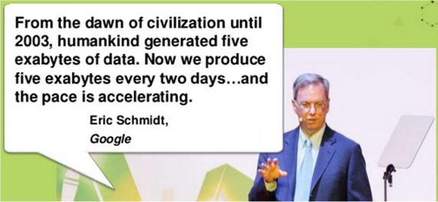
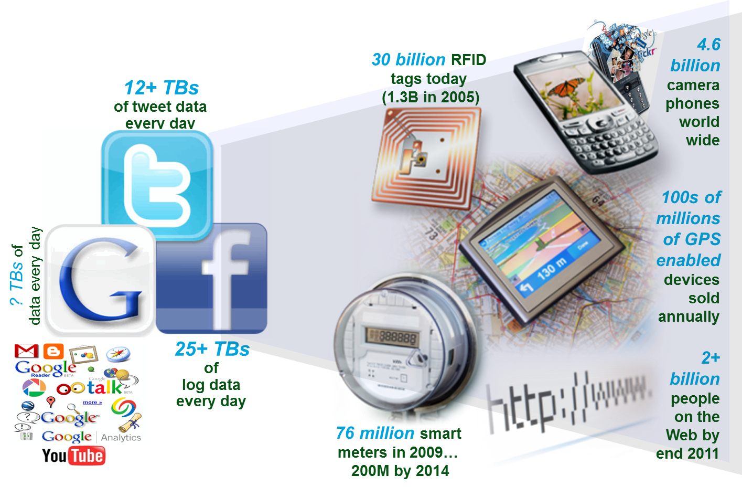
More Data for the Analysis
Source: Bernard Marr
Source: Ruoming Jin

Slide 7
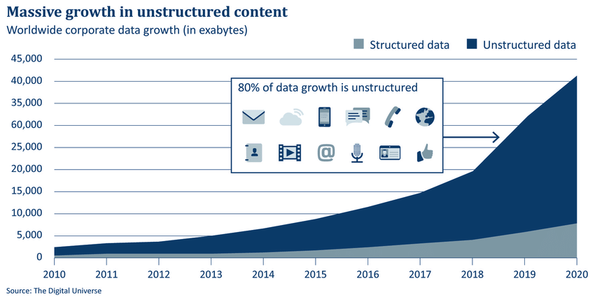
Worldwide Corporate Data Growth
Web, Cloud, Mobile, Social, Sensor Data
Business Transaction Data

Slide 8
Why is Modern Analytics so Successful?
More Data for the Analysis
More Computing Power
New Methods and Algorithms
New Analytics Processes

Slide 9
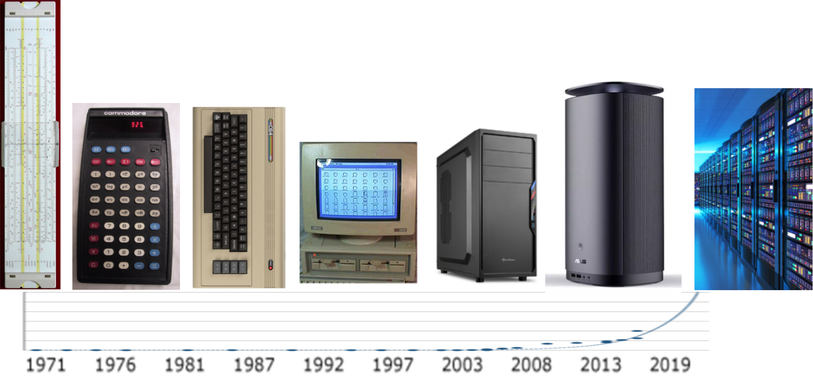
Growth of Computing Power

Slide 10
Why is Modern Analytics so Successful?
More Data for the Analysis
More Computing Power
New Methods and Algorithms
New Analytics Processes

Slide 11
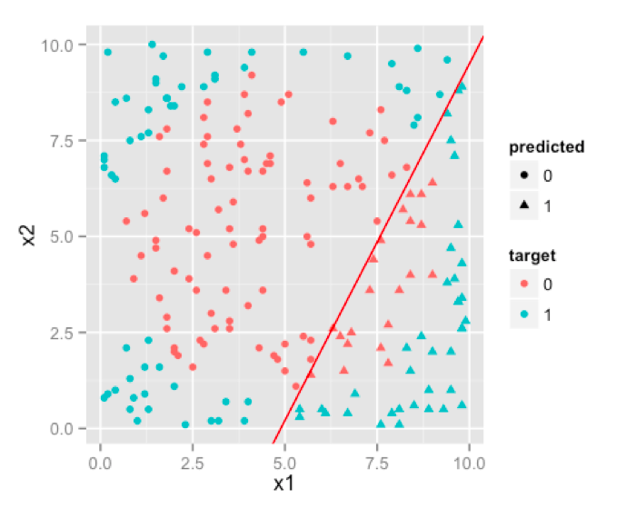
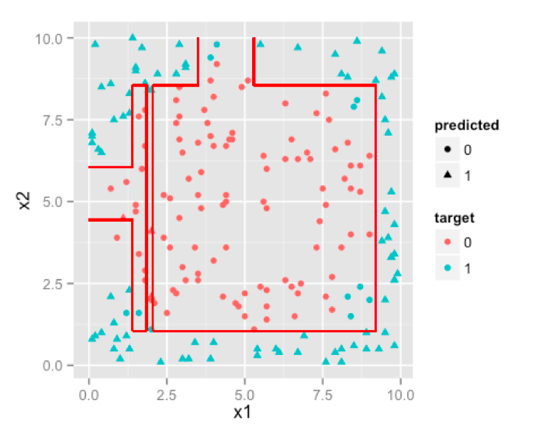
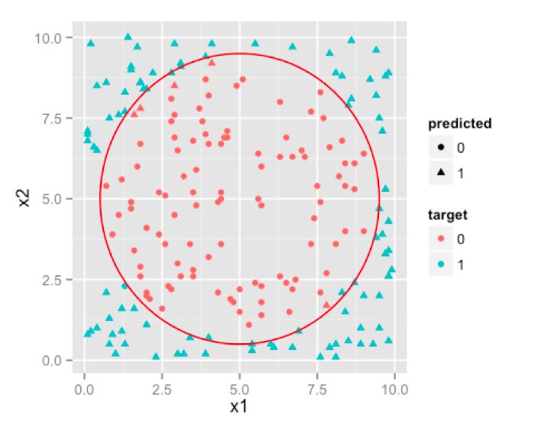
Old vs. New Methods
Traditional Regression
Decision Tree
Neural Network
Source: Lalit Sachan

Slide 12
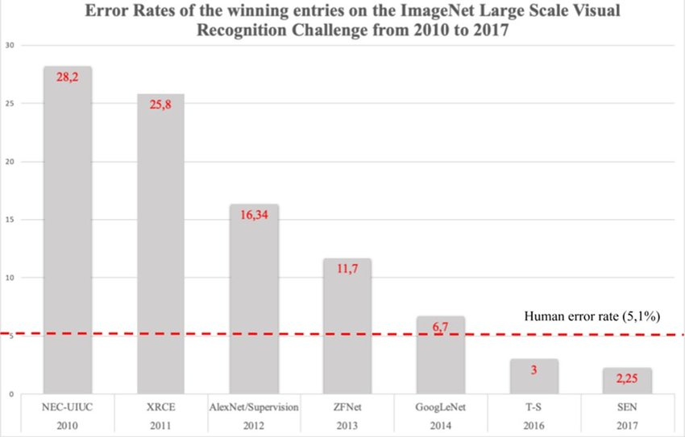
Decrease of Error Rates

Slide 13
Why is Modern Analytics so Successful?
More Data for the Analysis
More Computing Power
New Methods and Algorithms
New Analytics Processes

Slide 14
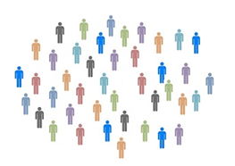
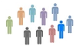

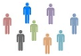
Traditional vs. Modern Analytics Process
Traditional Analytics Process:
validate
create
+
build
Sample
Algorithm
apply
Predictive Model
Reality
Modern Analytics Process:
Training Sample
Algorithm
+
build
create
adjust
validate
Test Sample
Predictive Model
Reality
apply

Slide 15

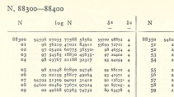
From the Past to the Present
1700
1800
1900
2000
1654 Mathematical Theory of Probability
1733 Normal Distribution
1795 OLS Regression
1888 Correlation
1937 Confidence Interval
1989 Neural Networks (ML)
Methods
Abacus, Calculating-Table, Lists, and Tables
1850 Slide Rule
1972 Pocket Calculator
1981 Personal Computer
Calcula-tion
Data on Paper
1985 Data Bases
2012
Big Data
Data

Slide 16
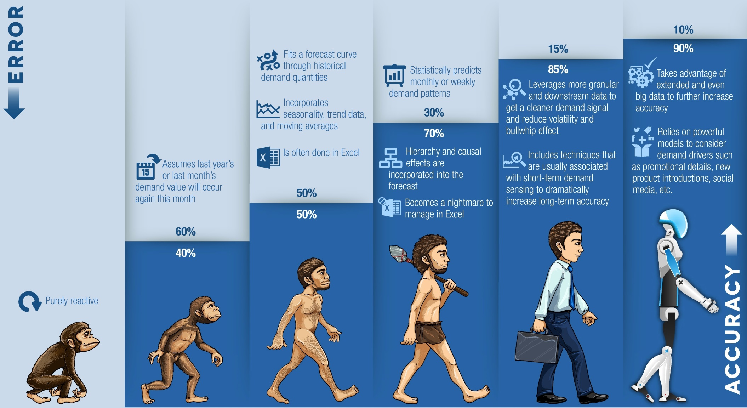
Evolution of Analytics
Source: http://juxt.pro/blog/posts/machine-learning-with-clojure.html

Slide 17
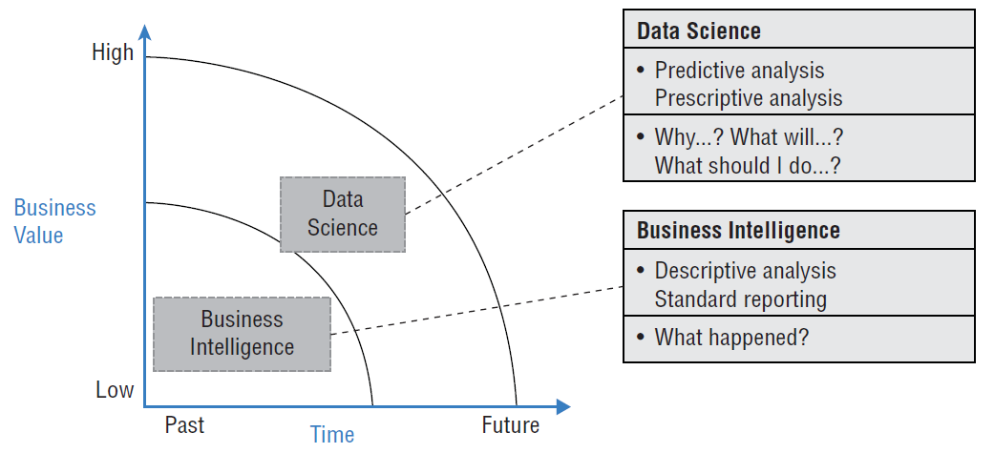
Types of Analytics (I)
Predictive / Prescriptive Analytics
Descriptive Analytics
Source: Schmarzo, p. 88

Slide 18
Types of Analytics (II)
Descriptive
What happend in the past?
Example: Report the profits of the last years
Predictive
Find patterns and relationships in data and use them for prediction.
Example: Find the functional relationship between price and demand
Prescriptive
Use the predictions to make decisions.
Example: Set the best price to optimize the profit.

Slide 19
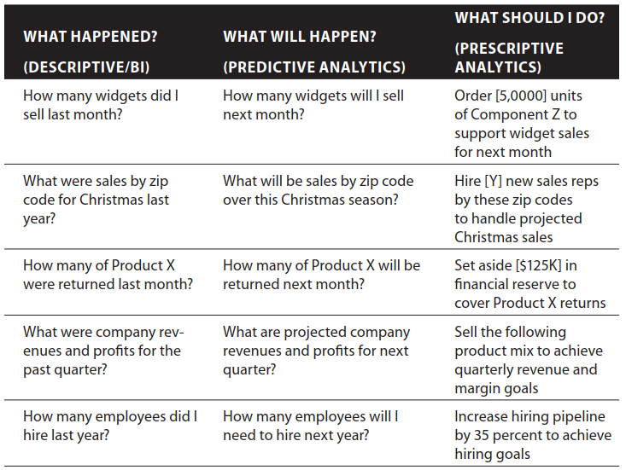
Types of Analytics (III)
Source: Schmarzo, p. 13

Slide 20
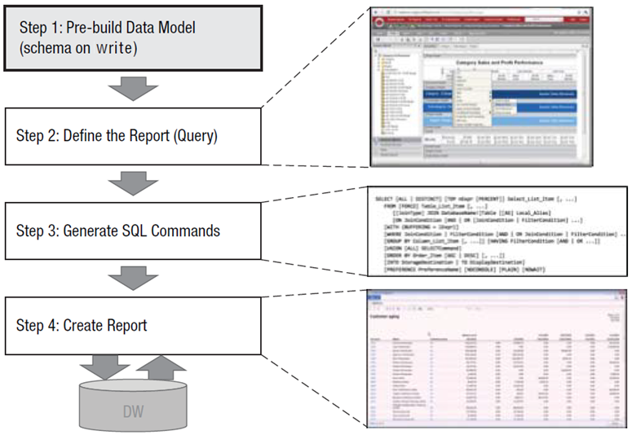
Descriptive Analytics Process

Slide 21
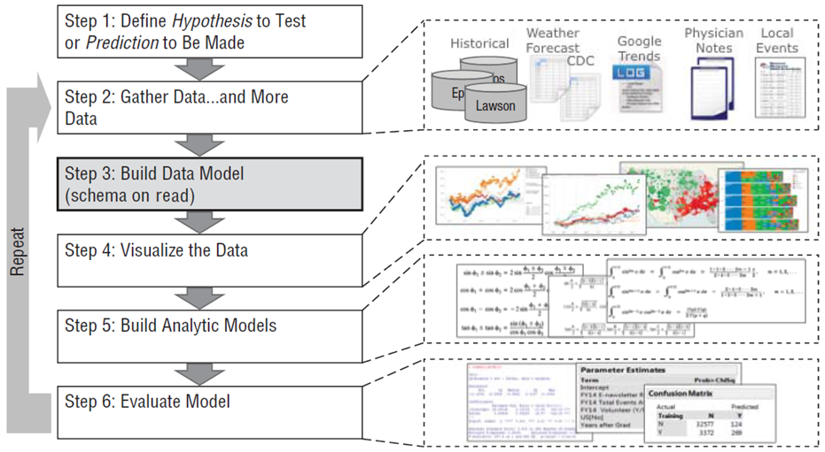
Predictive Analytics Process

Slide 22
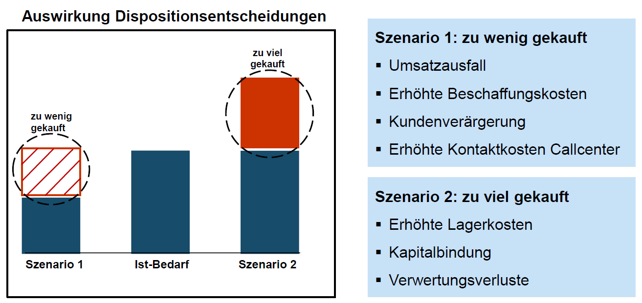
Example Inventory Planning
Impact of Disposition Decisions
Scenario 1: too little purchased
- Loss of turnover
- Increased procurement costs
- Customer annoyance
- Increased contact costs call center
too much purchased
too little purchased
Scenario 2: too much purchased
- Increased storage costs
- Capital lockup
- Utilization losses
Scenario 1 Actual demand Scenario 2
On the basis of more than 300 million data records per week, Otto makes more than one billion forecasts per year on the sales development of individual articles for the next days and weeks. Such forecasts allow Otto to reduce its own inventories by up to 30% on average.
Source: http://www.bvl.de/misc/filePush.php?mimeType=application/pdf&fullPath=/files/441/442/777/1015/DLK12_C3-3_Praesentation_Stueben.pdf

Slide 23
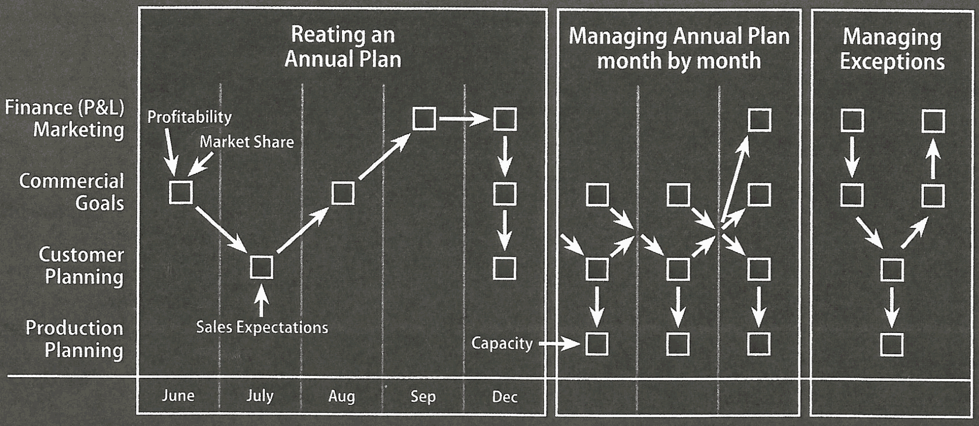
Classical Corporate Planning
Notes:
Die folgenden Ausführungen beziehen sich auf ein international operierendes US-amerikanisches Unternehmen der Konsumgüterindustrie. Das Ziel der Planung besteht darin, den Verantwortlichen im Unternehmen einen Rahmen zu geben, innerhalb dessen sie ihre Prozesse und Funktionen steuern können. Die Planung ist das Bindeglied zwischen den Zielen des Unternehmens und der Steuerung der einzelnen Prozesse im Tagesgeschäft. Im Folgenden werden die wesentlichen Schritte beschrieben.
Im Plan eines Geschäftsbereichs werden die finanziellen Erwartungen und die Erwartungen bezüglich Marktanteilen (Top-Down) mit den Umsatzerwartungen des Vertriebs (Bottom-Up) kombiniert. Die finanziellen Erwartungen an einen Geschäftsbereich leiten sich aus den Erwartungen des Kapitalmarkts an das gesamte Unternehmen ab. Sie werden als NOPAT (Net Operating Profit After Tax) formuliert und durch die Geschäftsleitung den einzelnen Geschäftsbereichen zugeordnet. Aus diesen Größen erstellen Finanz- und Rechnungswesen und Marketing Vorgaben für einzelne Produktkategorien und Produktgruppen. In diesem Verhandlungsprozess vertritt das Finanz- und Rechnungswesen die Margensicht, das Category-Management die Marktanteils- und Volumensicht. Direkte Produktionskosten und Kosten der Funktionsbereiche werden dabei weitgehend als gegeben angenommen. Aus diesem Verhandlungsprozess resultieren sogenannte Commercials Goals (Deckungsbeiträge und Mengen) für Marken, große Kunden und Monate.
Im Account-Management werden diese Commercial Goals mit den Absatzerwartungen abgeglichen. Dabei wird zunächst das sogenannte Base Business einschließlich der daraus resultierenden Deckungsbeiträge geplant. Dies basiert auf den Erfahrungswerten der Vergangenheit. Die Lücke zwischen diesen Werten und den Commercial Goals wird durch sogenannte Promotions (Aktionen) geschlossen. Promotions führen zu Mengensteigerungen, aber gleichzeitig zu Einbußen bei den Deckungsbeiträgen. Die Aufgabe des Account-Managements besteht also darin, durch Simulationen in der Preis-Absatz-Funktion einen Plan zu erstellen, der den Margen- und den Mengenerwartungen der Commercial Goals entspricht.
Diese Plandaten werden nun grob mit den Ressourcen der Produktion abgeglichen. Zeitliche und mengenmäßige Kapazitätsanpassungen sowie Veränderungen des Lagerbestands zwischen den Planperioden sind die Simulationsparameter der Produktion.
In einem Parallelprozess werden im Rechnungswesen gemeinsam mit den Fachbereichen die direkten Produktionskosten und die Funktionskosten geplant. Dieser Planungsprozess wird einmal jährlich durchgeführt sowie monatlich überwacht. Die Absatzpläne können monatlich geändert werden, die Commercial Goals lediglich quartalsweise. In gravierenden Ausnahmefällen werden die Pläne in einem jeweils individuellen Szenario geändert.

Slide 24
Example Driver-based Planing (I)
Sources
Forecasts
Driver
Planing/ Decision
Target

Slide 25
Example Driver-based Planing (II)
1
Volume
Turnover
2
Price
3
Commodities
EBITDA
4
Warehouse
Cost
Employees
...
...
1
Sales forecasts based on market and social media data
2
Automated pricing based on market and competitor analyses
3
Early detection of price changes and adjustment of purchasing behavior
4
Optimization of inventory management based on customers' current purchasing preferences

Slide 26
Navigation
2 Descriptive Analytics
2.1 Data Warehouse Systems
2.2 Online Analytical Processing (OLAP)

Slide 27
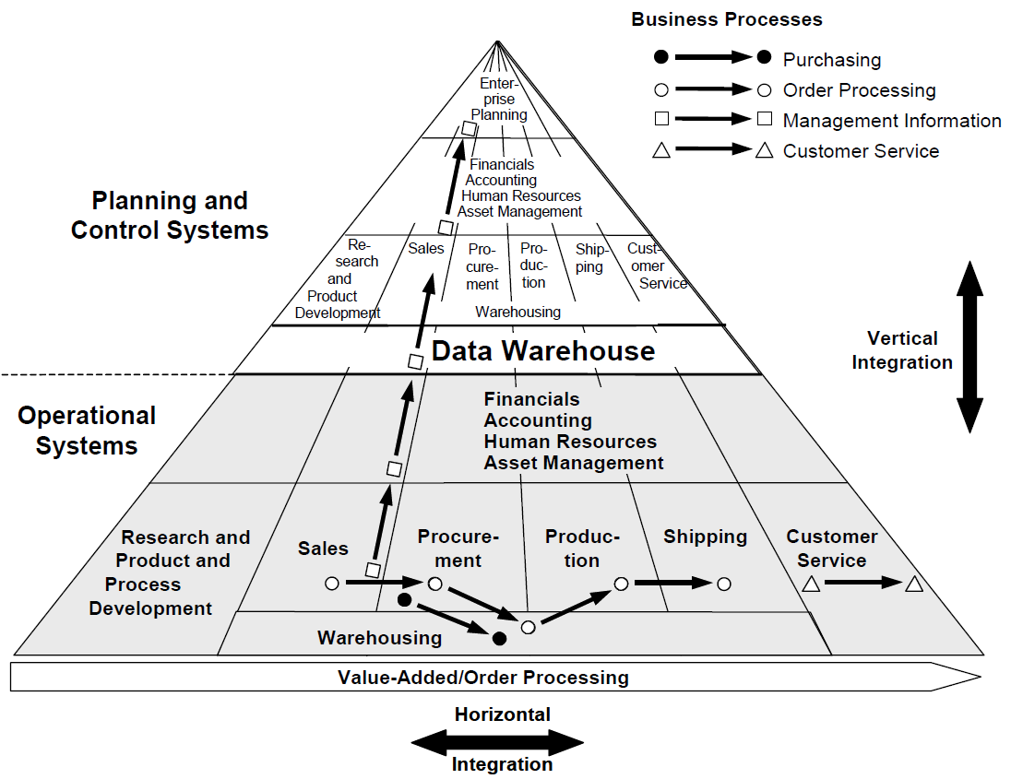
Application Systems Pyramid

Slide 28
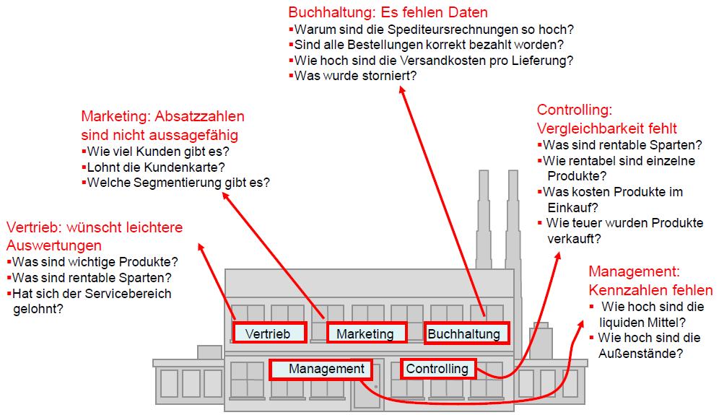
Typical Descriptive Questions
Accounting: Data is missing
- Why are the carrier invoices so high?
- Are all orders paid correctly?
- How much are the shipping costs per delivery?
- What has been cancelled?
Marketing: Sales figures are not meaningful
- How many customers exist?
- Is the customer card worth it?
- Which customer segments exist?
Controlling: Comparability is lacking
- What are profitable divisions?
- How profitable are individual products?
- How much do products cost in purchasing?
- How much were products sold for?
Sales: wants easier evaluations
- What are important products?
- What are profitable lines of business?
- Is the service area profitable?
Management: Key figures are missing
- What is the level of cash and cash equivalents?
- How high are the accounts receivable?
Sales
Accounting
Source: Alfred Schlaucher, Oracle, p. 15

Slide 29
Characteristics of Operational and Analytical Databases
Characteristics
Target group
Access frequency
Data volume per access
Required response time
Level of data
Queries
Given period
Time horizon
Operational Data
Operational employees
high
low to medium volume
very short
detailed
predictable, periodic
current
1-3 months
Analytical Data
Management, Analysts, Divisional manager
slow to medium
high volume
short to medium
aggregated, processed
unpredictable, ad hoc
past to future
several years up to decades

Slide 30
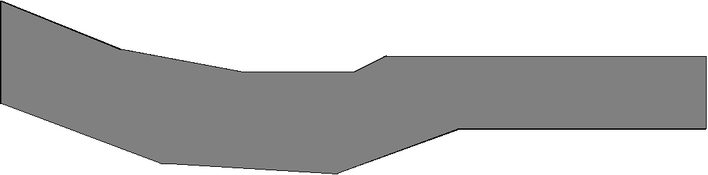
Contradiction between Operational Data Architecture and Analytical Information Needs
Customer View
Source: Jung/Winter (2000): Data Warehousing Strategie: Erfahrungen, Methoden, Visionen, Berlin, p. 7.

Slide 31
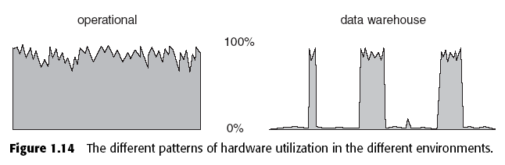
Different Intensities of Use
The hardware load differs in operational application systems and data warehouse systems over time
=> A data warehouse relieves the operational systems
Load
Time
Time
Source: Inmon: Building the Data Warehouse, 2002, p. 23.

Slide 32
Definition: Data Warehouse
The term Data Warehouse was coined by Bill Inmon in 1990, which he defined in the following way:
"A data warehouse is a subject-oriented, integrated, time-variant and non-volatile collection of data in support of management's decision making process."
He defined the terms in the sentence as follows:
Subject Oriented: Data that gives information about a particular subject instead of about a company's ongoing operations.
Integrated: Data that is gathered into the data warehouse from a variety of sources and merged into a coherent whole.
Time-variant: All data in the data warehouse is identified with a particular time period.
Non-volatile: Data is stable in a data warehouse. More data is added but data is never removed. This enables management to gain a consistent picture of the business
Source: "What is a Data Warehouse?" W.H. Inmon, Prism, Volume 1, Number 1, 1995

Slide 33
The Data Warehouse Concept
Operational
Application
System
Operational
Application
System
Analytical
Application
System
(e.g. CRM)
Reporting
System
(e.g.
Controlling)
Predictive Analytics
Data Warehouse
Target,
Actual,
Devia- tion
Pro-
ducts
Regions
Custo- mers
Time
Dimensions
Operational Databases
External Databases

Slide 34
Layers of a Data Warehouse System
Extraction
Transfor-mation
Loading

Slide 35
Components of a Data Warehouse
Metadata
Repository
Data Base
Loader
Staging Area
ETL Process
Transformator
Monitor/
Extractor
Monitor/
Extractor
Monitor/
Extractor
Monitor/
Extractor
Oracle
DB/2
IMS
. . .
operational
Datenbase
operational
Datenbase
operational
Datenbase
operational
Datenbase

Slide 36
Structure of the Database
The database represents the core of the data warehouse. It contains current and historical data from all relevant areas of the company. In contrast to the operational databases, the data here is not structured according to the business processes and functions of the company, but is aligned with the facts that determine the company. They are organized in such a way that they can be viewed from different dimensions.
Frequently used dimensions are:
Company structure (e.g., business units, organizational structure, and legal entities)
Product structure (e.g. product groups and individual products)
Regional structure (e.g. region, country, continent)
Customer structure (e.g. customer groups or segments and individual customers)
Time structure (e.g. month, quarter, year)
Business parameters (e.g. sales, contribution margin, profit)
Characteristics (e.g. target, actual, deviations)

Slide 37
Examples of Aggregation Levels in a Data Warehouse
Customers Total
Sales Area Total
Customer Groups
Countries
Individual Customers
Regions

Slide 38
ETL-Tools
The data in the data warehouse can normally only be accessed in a read-only manner. The only exception to this are ETL tools, which are responsible for transferring data from internal and external information sources. They automate the process of data acquisition from internal and external information sources.
The timeliness with which the transfer to the database is to take place can be defined flexibly, e.g. within defined time intervals, immediately after each change or at the explicit request of the user.
ETL programs include:
Monitors: Detect and report changes in individual sources that are relevant to the data warehouse
Extractors: select and transport data from the data sources into the workspace
Transformers: Unify, clean, integrate, consolidate, aggregate, and augment extracted data in the workspace
Loaders: Load transformed data from the workspace into the data warehouse after the data retrieval process is complete

Slide 39
Staging Area
The staging area is a temporary cache that performs the ETL process. It includes the extraction, transformation and loading of the data into the data warehouse.
Neither the operational systems nor the data warehouse are affected by the process. The data can be transferred incrementally from the operational systems without having to have a permanent connection to them. It is stored temporarily and only transformed when it is sufficiently complete.
It is then loaded en bloc into the data warehouse, so that no inconsistencies can occur here either.
If the ETL process is successful, the data is deleted from the staging area.

Slide 40
The Metadata Repository
Metadata supports data management and serves as a descriptor for an object that holds some data or information. In data warehouses, it is collectively organized in a catalog called metadata repository.
Metadata is classified into three types:
Technical metadata gives information about the structure of data, where it resides, and other technical details related to finding data in its native database.
Business metadata describes the actual data in terms, which is understandable from the business side. It can provide insights into the type of data, its origin, its definition, its quality level, the relationship among other entities in a data warehouse, etc.
Process metadata stores information about the occurrence and outcomes of all the operations taking place in the data warehouse.

Slide 41
Data Warehouse and Data Mart
A single-subject data warehouse is typically referred to as a Data Mart, while Data Warehouses are generally enterprise in scope
Comparison: Data Warehouse and Data Mart
Data Mart
Division/Department
Optimized
From gigabyte range
Task oriented
Specific
Data Warehouse
Company
Generalistic
From terabyte range
Data model oriented
Versatile
Application
Data design
Data volume
Origin
Requirements

Slide 42
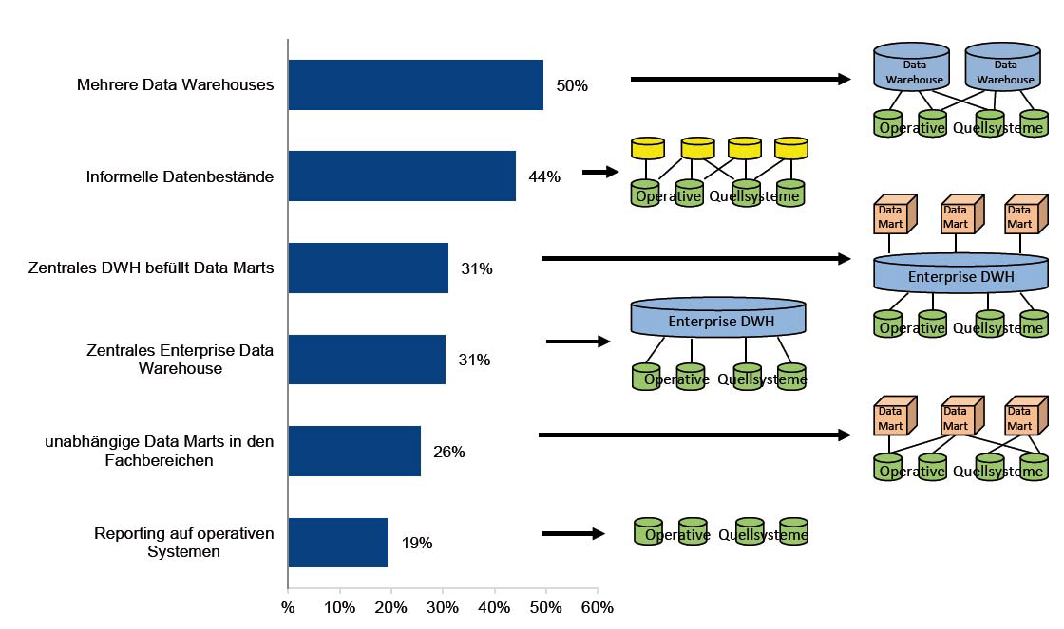
Architectural Variants of Data Warehouses in Practice
Multiple Data Warehouses
lnformal Data Warehouses
Central DWH fills Data Marts
Central Enterprise DataWarehouse
Independent Data Marts in the Departments
Reporting on OperationalSystems

Slide 43
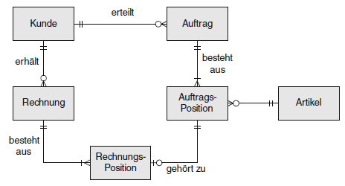
From Transactions to Reports
Transactional (operational) Model
Report
places
Customer
Order
receives
consists of
Invoice
Order Position
Product
consists of
Invoice Position
belongs to
Customer Type
Customer
Product Group
Product
Sales
Month
Year
Source: Müller/Lenz (2013), p. 16f
Region
Analytical Model
Country

Slide 44
Example of a Dashboard
Source: https://www.bluemargin.com/power-bi-full-blog/topic/private-equity-data-intelligence

Slide 45
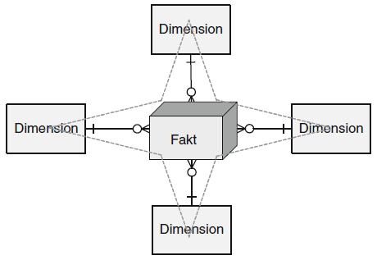
Star Schema (I)
The Star schema has a central fact table and exactly one dimension table for each dimension.
The cardinality between the fact table and a dimension table is n∶1, i.e. a fact (e.g. sales: 67,000 euros) is described by one dimension expression for each dimension (e.g. time: 1st quarter, region: Hesse, product group: books). A dimension characteristic (e.g. product group: books) is associated with 0, 1 or n facts.
Fact
Source: Müller/Lenz (2013), p. 60f

Slide 46
Star Schema (II)
Hesse
Books
Where?
With what?
Sales = 67,000 Euros
When?
1. Quarter

Slide 47
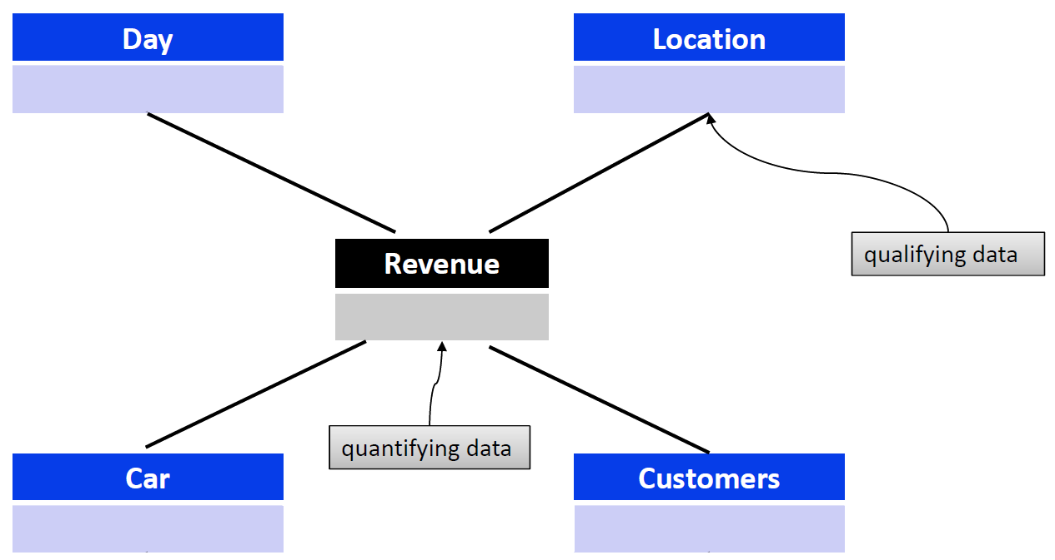

Star Schema (III)
01.02.2014
Frankfurt
München
Hessen
München
2000
617
22
1600
All Cars
All Customers

Slide 48
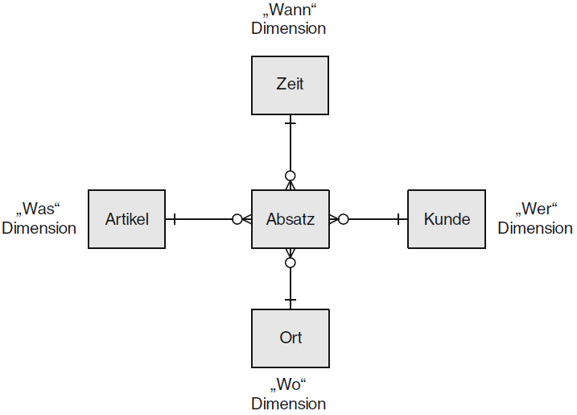
Star Schema Table Design (I)
"When"
Time
Time
"What"
Product
Sales Cost
Person
"Who"
Location
"Where"
Sourcee: Müller/Lenz (2013), p. 61

Slide 49
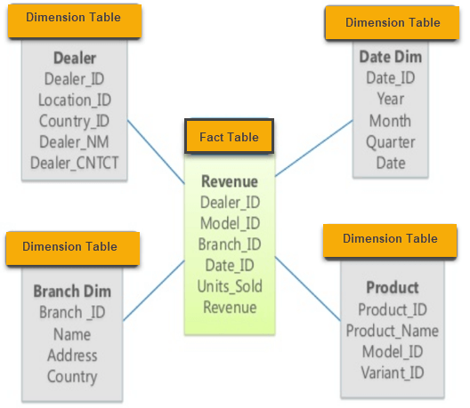
Star Schema Table Design (II)
Multiple Facts Possible
Source: https://www.guru99.com/star-snowflake-data-warehousing.html

Slide 50
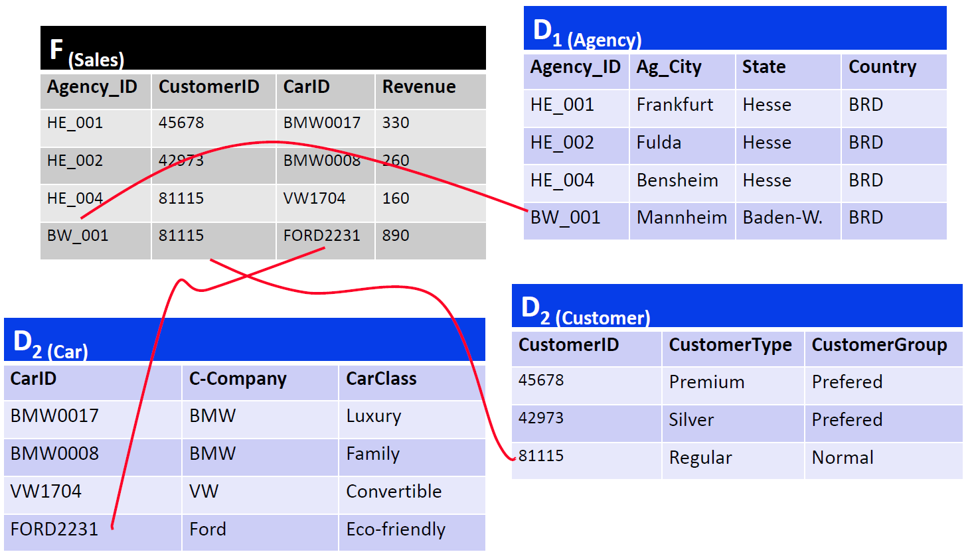
Star Schema Example

Slide 51
Exercise 1
An online wine retailer plans to design a data warehouse to collect key figures regarding its wine sales. The relevant part of the operational database consists of the following tables:
CUSTOMER (ID, name, address, telephone, birthday, gender)
WINE (ID, name, type, year, bottle_price, class)
CLASS (ID, name, region)
TIME (timestamp, date, year)
ORDER (customer, wine, time, bottles)
Create the star schema for the data warehouse.

Slide 52
Queries on the Star Schema
Example:
In which years were the most cars purchased by female customers in Hesse in the 1st quarter?
select z.Year as Year, sum(v.Amount) as Total_Amount
from Branch f, Product p, Time z, Customer k, Sales v
where z.Quarter = 1 and k.gender = ’f’ and p.Product_type = ’Car’ and f.state = ’Hesse’ and v.Date = z.Date and v.ProductID = p.ProductID and v.Branch = f.Branchname and v.CustomerID = k.CustomerID
group by z.Year
order by Total_Amount Descending;
Year Total_Amount
2004 745
2005 710
2003 650
Source: Hartung (2011), p. 37

Slide 53
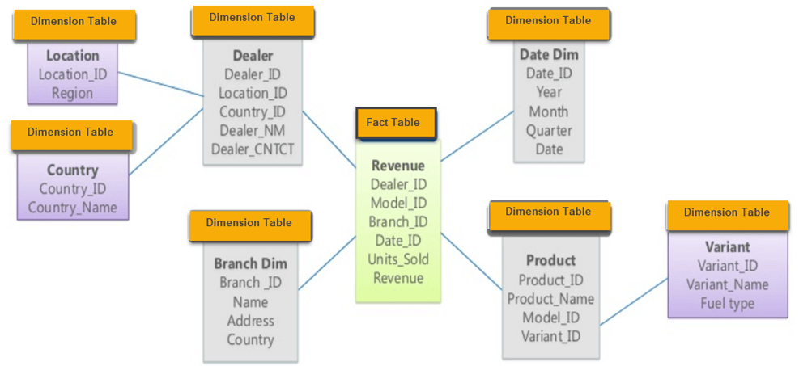
Snowflake Schema
In the Snowflake schema, the redundancies in the Star schema are resolved in the dimension tables and the hierarchy levels are each modeled with their own tables:
Source: https://www.guru99.com/star-snowflake-data-warehousing.html

Slide 54
Star Schema vs. Snowflake Schema
- Speed of query processing is in favor of Star scheme
- Data volume tends to be lower with Snowflake schema
- Snowflake schema is easier to change (maintenance)

Slide 55
Galaxy Schema
The Galaxy schema contains more than one fact table. The fact tables share some but not all dimensions. The Galaxy schema thus represents more than one data cube (multi-cubes):

Slide 56
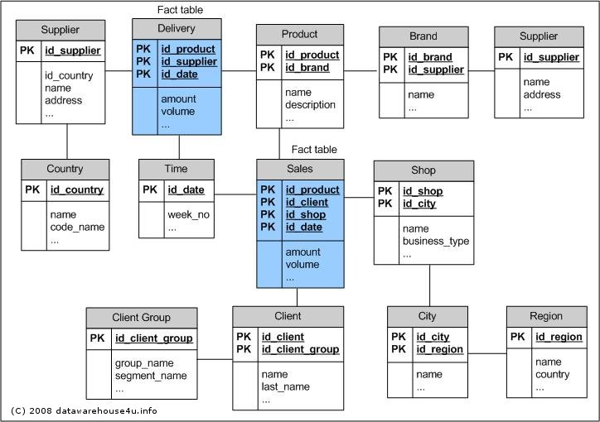
Table Structure of the Galaxy Schema

Slide 57
DW Planning – User Questions (I)
What is the ratio of private to corporate customers?
Does this quantity ratio correspond to the turnover ratio?
Do customer characteristics such as occupational group, living situation, education, etc. play a role in turnover? What are the customers with the highest sales?
What is the development of sales over time? Are there any shifts in relation to customer characteristics?
Can additional customer segments be formed, e.g. if customer characteristics are combined?
Are there regional focal points in relation to customer characteristics?
Are there regional focuses related to products / product groups?
Are there correlations between customer characteristics and products?
What are the top-selling products? Top sellers/bottom sellers lists?
Are there seasonal influences on the sales development depending on product or customer characteristics?
Source: Alfred Schlaucher, Oracle, p. 27

Slide 58
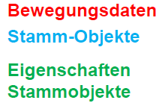
DW Planning – User Questions (II)
What is the ratio of private to corporate customers?
Does this quantity ratio correspond to the turnover ratio?
Do customer characteristics such as occupational group, living situation, education, etc. play a role in turnover? What are the customers with the highest sales?
What is the development of sales over time? Are there any shifts in relation to customer characteristics?
Can additional customer segments be formed, e.g. if customer characteristics are combined?
Are there regional focal points in relation to customer characteristics?
Are there regional focuses related to products / product groups?
Are there correlations between customer characteristics and products?
What are the top-selling products? Top sellers/bottom sellers lists?
Are there seasonal influences on the sales development depending on product or customer characteristics?
Transaction Data
Master Data
Properties Master Data
Master Data Candidates for Dimensions
Transaction Data Candidates for Facts
Source: Alfred Schlaucher, Oracle, p. 28

Slide 59
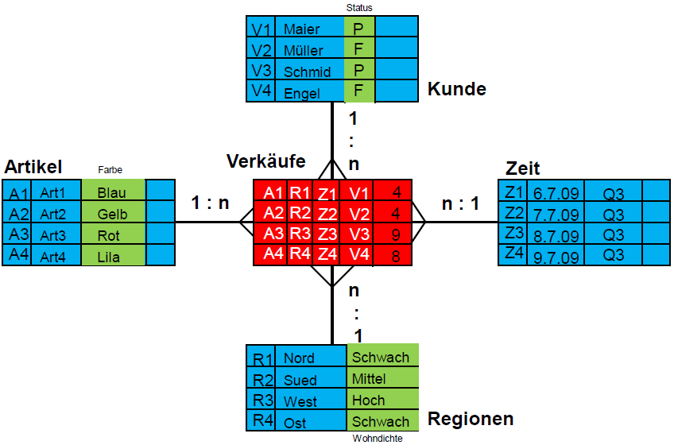
Result: Star Schema
Customer
Product
Sales
Time
Source: Alfred Schlaucher, Oracle, p. 40

Slide 60
Exercise 2
A restaurant chain wants to build a management information system. The application system architecture is to be aligned with the data warehouse concept. An OLAP system is chosen for report generation.
The company maintains various restaurants, which can be differentiated by region and by renovation status. The Leonardo-Campus restaurant belongs to the North region and is New from the renovation status. The restaurant Nordblick is also located in the North region, but its renovation status is Old. The Spätzleburg restaurant, on the other hand, is in the South region and has a New renovation status.
The menu items of the restaurants are divided into the classes "Starters", "Main courses", "Desserts", "Beverages" and "Other". Time-based analyses are to enable evaluations by days of the week, weeks, months and years. Simple contribution margin calculations for restaurants, services and days are to be supported. The contribution margin is mathematically calculated from sales minus costs.
Create the logical data warehouse schema!

Slide 61
Exercise 3
As an employee of the Controlling department, you will be given the task of setting up a data warehouse for sales and headcount analyses.
Flowers GmbH has two branches in Hesse, one in Rhineland-Palatinate and three in France. Product categories include cut flowers, garden flowers and bridal jewelry. Within garden flowers, the rose family includes the genera roses and wild roses. Products in the rose genus include thornless roses and roses with thorns. The company distinguishes between corporate and private customers. Data about the place of residence of the customers is available.
The DWH should be able to generate daily and weekly analyses as well as monthly, quarterly and annual reports.
The key figure required for the sales analyses is the profit, which is calculated from the difference between revenues and costs.
Employees have been working in the different branches of the company for different periods of time. The DWH should also enable headcount analyses. The key figure required for this is the headcount.
Create the logical data warehouse schema!

Slide 62
Navigation
2 Descriptive Analytics
2.1 Data Warehouse Systems
2.2 Online Analytical Processing (OLAP)

Slide 63
Subject of OLAP
Online Analytical Processing (OLAP) is software technology focused on the analysis of dynamic, multidimensional data.
The goal is to provide executives with the information they need quickly, flexibly and interactively.
OLAP functionality can be characterized as dynamic, multidimensional analysis of consolidated enterprise data, which includes the following components:
Calculations of key figures over different dimensions and aggregation levels
Trend analysis over definable time intervals
"What if" analyses
Multidimensional visualization methods

Slide 64
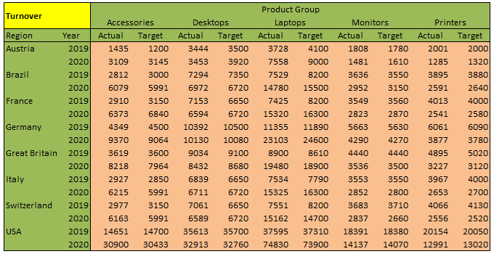
Facts and Dimensions
Qualifying Information (Dimensions)
Quantifying Information (Facts)

Slide 65
Organizing Data as Hypercube
Dimension 3
Fact (e.g. Turnover)
Advantages:
Facts must not be calculated manually for any chosen view on the cube.
Arbitrary views can be easily created.
Such a cube can have any number of dimensions which allows a higher complexity.
Dimension 2
Dimension 1 (e.g. Region)

Slide 66
OLAP Operations: Slicing and Dicing
Time
Time
Time
Product
Product
Product
Region
Region
Region
The slicing operator selects tuples from the cube according to the selection condition. The operator specifies one or more values for at least one dimension and thus slices a "slice" from the data cube.
Product
Region
Time
Time
The dicing operator selects a subset of the dimensions of the cube and uses it to cut out a smaller "sub-cube".
Product
Product
Region
Time
Source: Müller/Lenz (2013), p. 54
Region

Slide 67
OLAP Operations: Rotate
The rotate operator rotates the hypercube around one of its axes:
Time
Region
Product
Product
Region
Time

Slide 68
OLAP Operations: Drill Down and Roll Up
The roll-up operator corresponds to aggregation and goes from the specific up to the general in the dimensional hierarchy; conversely, drill-down goes as disaggregation from the general down to the specific in the hierarchy.
Region
Source: Müller/Lenz (2013), p. 55
Product
Time
Region
Product
y
c
c
Time

Slide 69
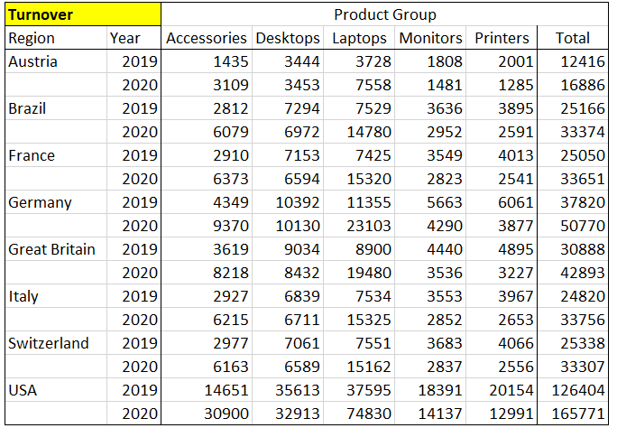
OLAP Operations: Nest
The result of a nest operation physically represents a two-dimensional matrix. It is extended by displaying different hierarchy levels of one or more dimensions on one axis (column or row) in nested form. In the following example, three dimensions are displayed:
3
1
2

Slide 70
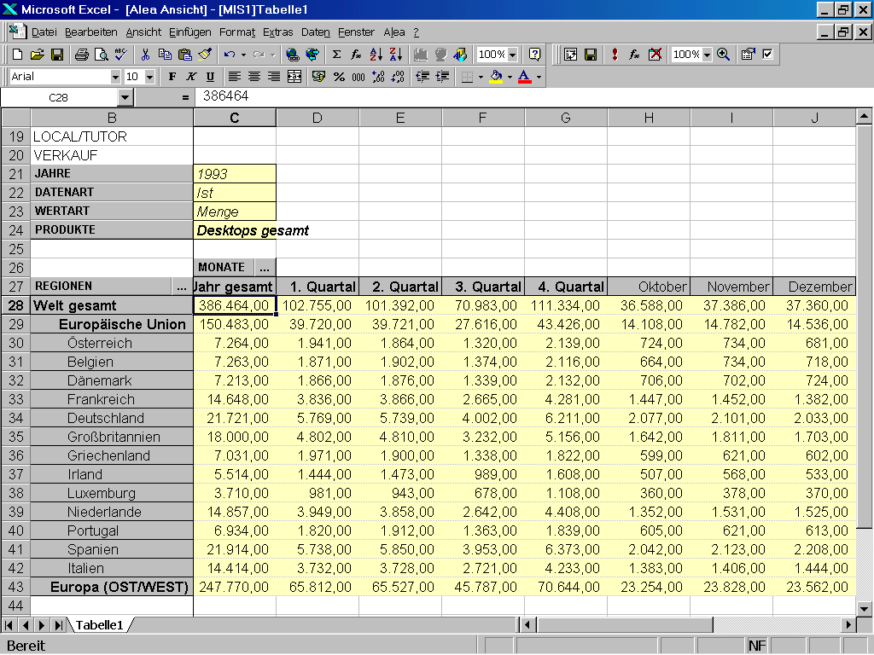
OLAP as Excel plug-in

Slide 71
Architecture of an OLAP System
Enduser Computer (e.g. with Excel and OLAP plug-in)

Slide 72
Navigation
3 Big Data

Slide 73
Limitations of the Data Warehouse Approach
Traditional DWH solutions are designed to provide a single point of truth. Important aspects are:
Merge and unify data from multiple data sources
High data quality
Proper historization of the data
Data Governance and Compliance
This results in the following problem areas in today's world:
Lack of flexibility due to high effort for changes
Time expenditure due to transfer from the operational sources and the aggregations
Past orientation of data (snapshot of the past); There is an increasing need for ad hoc and real-time analyses
Partial knowledge, as only structured data is stored with increasing need for social media data, etc.
Patchwork; due to gradual introduction of data warehouses, many solution islands exist and are operated separately from each other both technically and methodologically

Slide 74
What is Big Data?
The basic idea behind the phrase 'Big Data' is that everything we do is increasingly leaving a digital trace (or data), which we (and others) can use and analyze. -- Bernard Marr
Big Data is the frontier of a ﬁrm’s ability to store, process, and access (SPA) all the data it needs to operate effectively, make decisions‚ reduce risks, and serve customers. -- Forrester
Big Data is not about the size of the data, it's about the value within the data. -- David Wellman

Slide 75
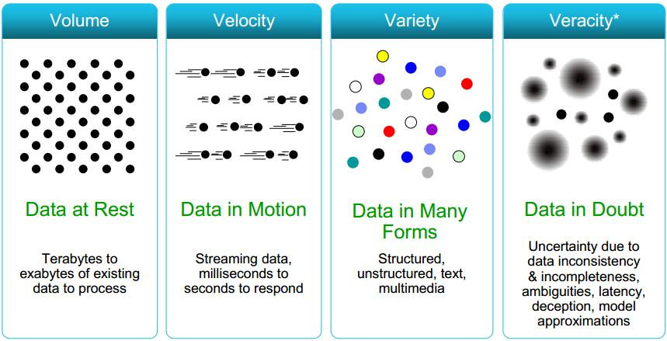
4V’s of Big Data
Source: www.cs.kent.edu/~jin/BigData/Lecture1.pptx

Slide 76
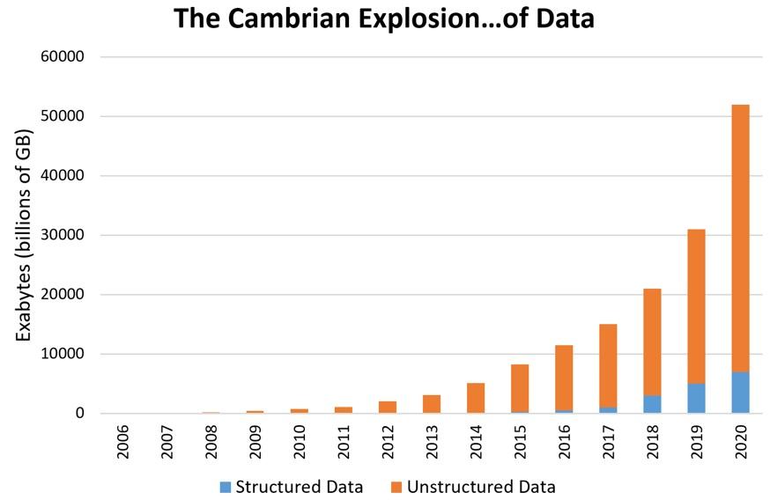
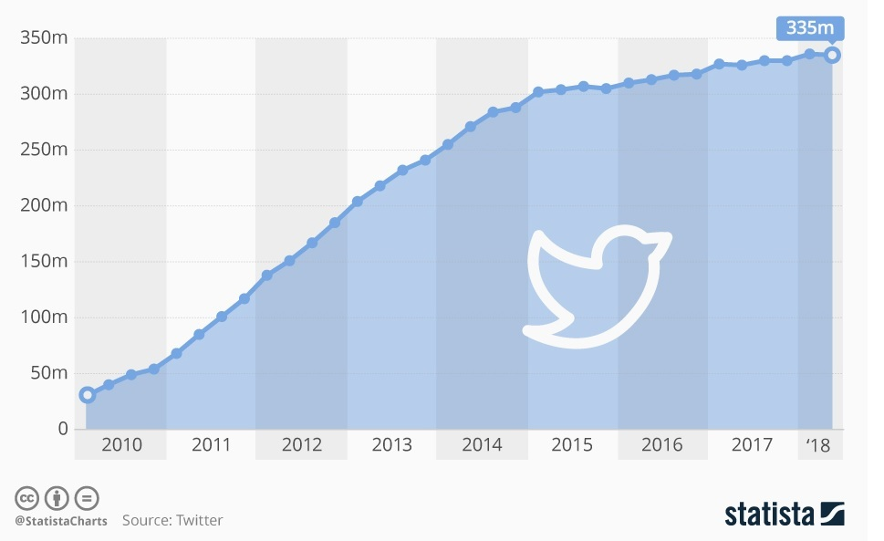
Volume (Scale)

Slide 77


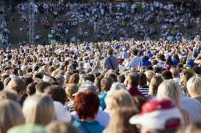

The Model of Generating and Consuming Data has Changed
Old Model: Few companies are generating data, all others are consuming data
New Model: all of us are generating data, and all of us are consuming data
Source: www.cs.kent.edu/~jin/BigData/Lecture1.pptx

Slide 78





Collecting Data
4.6 billion camera phones world wide
30 billion RFID tags today (1.3B in 2005)
12+ TBs of tweet data every day
100s of millions of GPS enabled devices sold annually
? TBs of data every day
25+ TBs of log data every day
2+ billion people on the Web by end 2011
76 million smart meters in 2009… 200M by 2014
Source: www.cs.kent.edu/~jin/BigData/Lecture1.pptx

Slide 79
Types of Data People are Creating (I)
Activity Data
Simple activities like listening to music or reading a book are now generating data. Digital music players and eBooks collect data on our activities. Your smart phone collects data on how you use it and your web browser collects information on what you are searching for. Your credit card company collects data on where you shop and your shop collects data on what you buy. It is hard to imagine any activity that does not generate data.
Conversation Data
Our conversations are now digitally recorded. lt all started with eMails but nowadays most of our conversations leave a digital trail. Just think of all the conversations we have on social media sites like Facebook or Twitter. Even many of our phone conversations are now digitally recorded.
Photo and Video Image Data
Just think about all the pictures we take on our smart phones or digital cameras. We upload and share 100s of thousands of them on social media sites every second. The increasing amounts of cameras take video images and we upload hundreds of hours of video images to YouTube and other sites every minute.
Source: http://de.slideshare.net/BernardMarr/140228-big-data-slide-share/3-The_basic_idea_behind_the

Slide 80
Types of Data People are Creating (II)
Sensor Data
We are increasingly surrounded by sensors that collect and share data. Take your smart phone, it contains a global positioning sensor to track exactly where you are every second of the day, it includes an accelometer to track the speed and direction at which you are travelling. We now have sensors in many devices and products.
The Internet of Things Data
We now have smart TVs that are able to collect and process data, we have smart watches, smart fridges, and smart alarms. The Internet of Things, or Internet of Everything connects these devices so that e.g. the traffic sensors on the road send data to your alarm clock which will wake you up earlier than planned because the blocked road means you have to leave earlier to make your 9am meeting.
Source: http://de.slideshare.net/BernardMarr/140228-big-data-slide-share/3-The_basic_idea_behind_the

Slide 81
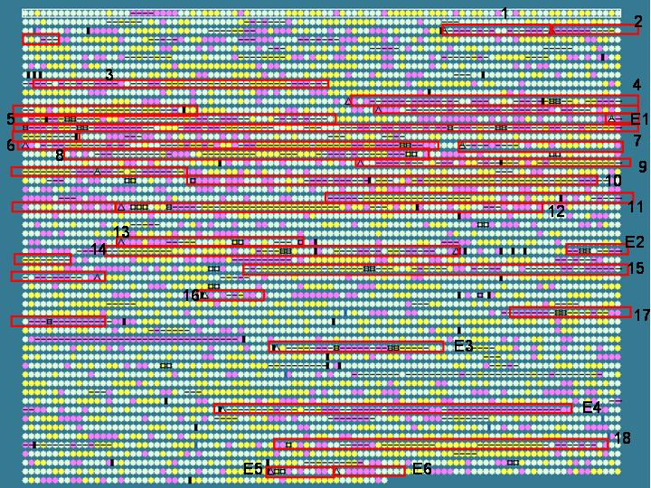

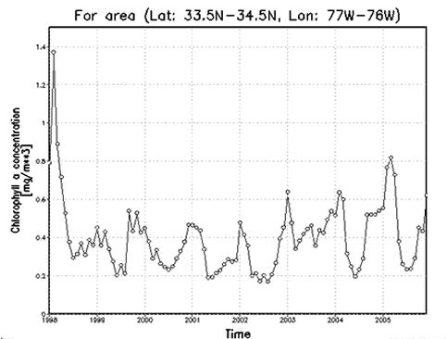

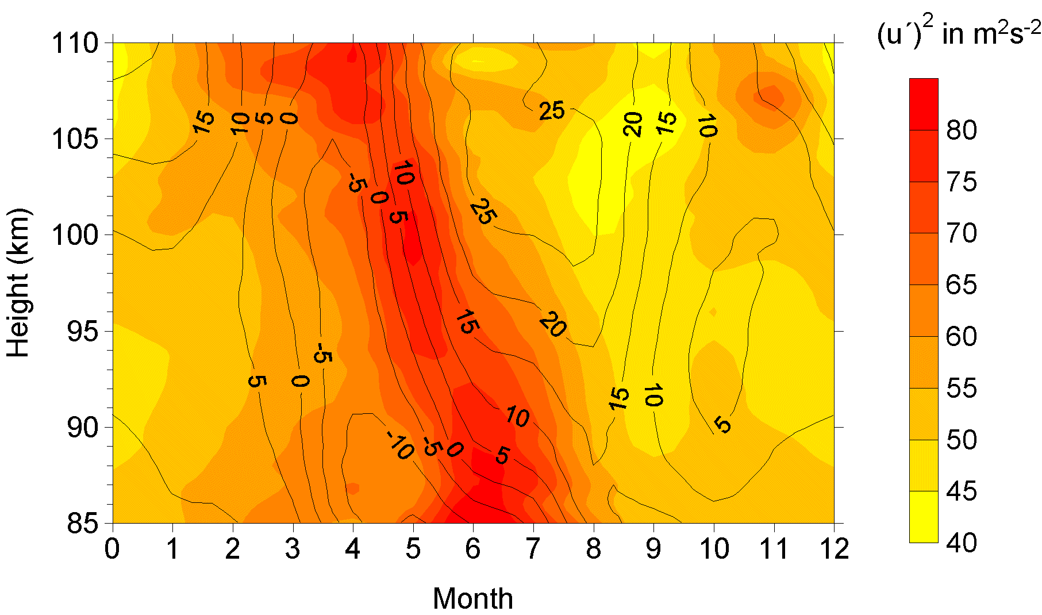

Variety (Complexity)
Relational Data (Excel, CSV, Relational Database)
Text Data (Web)
Semi-structured Data (XML/JSON)
Graph Data
Social Network, Semantic Web, …
Streaming Data
You can scan the data only once
Source: www.cs.kent.edu/~jin/BigData/Lecture1.pptx

Slide 82

















A Single View to the Customer
Social Media
Banking
Finance
Gaming
Our
Known
History
Customer
Entertain
Purchase
Source: www.cs.kent.edu/~jin/BigData/Lecture1.pptx

Slide 83

Velocity (Speed)
Data is being generated fast and needs to be processed fast
Late decisions result in missing opportunities
Examples
E-Promotions: Based on your current location, your purchase history, what you like ➔ send promotions right now for store next to you
Healthcare monitoring: sensors monitoring your activities and body ➔ any abnormal measurements require immediate reaction
Production and Logistics: Due to the direct connection to the POS systems of the stores, Langnese is able to control and adjust its production and delivery in real-time As a consequence, millions of euros can be saved monthly.
Source: www.cs.kent.edu/~jin/BigData/Lecture1.pptx

Slide 84
Real-Time Analytics
Product
Recommendations
that are Relevant
& Compelling
Learning why Customers
Switch to competitors
and their offers; in
time to Counter
Influence
Behavior
Customer
Friend Invitations
to join a
Game or Activity
that expands
business
Improving the
Marketing
Effectiveness of a
Promotion while it
is still in Play
Preventing Fraud
as it is Occurring
& preventing more
proactively
Source: www.cs.kent.edu/~jin/BigData/Lecture1.pptx

Slide 85
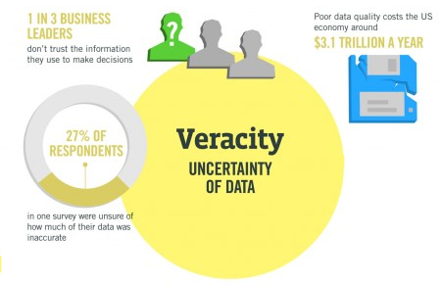
Veracity (Uncertainty)
Source: http://www.ibmbigdatahub.com/ infographic/four-vs-big-data
Organizations must now analyze both structured and unstructured data that is uncertain and imprecise.
In many cases, it is not known whether the data is correct (e. g. fake news) or representative (e. g. biased expressions of opinion in forums).
It may be prudent to assign a Data Veracity score and ranking for specific data sets to avoid making decisions based on analysis of uncertain and imprecise data.

Slide 86
How is Big Data actually used?
Better understand and target customers Companies expand their traditional data with social media data, browser, text analytics or sensor data to get a more complete picture of their customers.
Understand and Optimize Business Processes Retailers are able to optimize their stock based on predictive models generated from social media data, web search trends, weather forecasts...
Improving Health Use the data from smart watches, wearable devices, Google Trends, health research, electronic medical record to diagnose disease, predict epidemics, …
Improving Security and Law Enforcement Use big data analytics to predict criminal activity, foil terrorist plots, detect cyber attacks, and detect fraudulent credit card transactions.
Improving and Optimizing Cities and Countries (Smart Cities) Optimize traffic flows based on real time traffic information, social media and weather data. A bus would wait for a delayed train and traffic signals predict traffic volumes.
...
Source: http://de.slideshare.net/BernardMarr/140228-big-data-slide-share/3-The_basic_idea_behind_the

Slide 87
Turning Big Data into Value
The Datafication of our World:
Activities
Conversations
Words
Voice
Social Media
Browser Iogs
Photos
Videos
Sensors
Etc.
Analyzing Big Data:
Data analytics
Text analytics
Sentiment analysis
Face recognition
Voice analytics
Movement analytics
Etc.
Volume
Velocity
Value
Variety
Veracity
Source: http://de.slideshare.net/BernardMarr/140228-big-data-slide-share/3-The_basic_idea_behind_the

Slide 88
The Four Layers of Big Data (I)
4. Data Output Layer
3. Data Processing/ Analysis Layer
Data Source Layer
This is where the data arrives at the organization. It includes everything from sales records, customer database, feedback‚ social media channels, marketing list, email archives etc.
2. Data Storage Layer
1. Data Source Layer
Source: http://de.slideshare.net/BernardMarr/140228-big-data-slide-share/3-The_basic_idea_behind_the

Slide 89
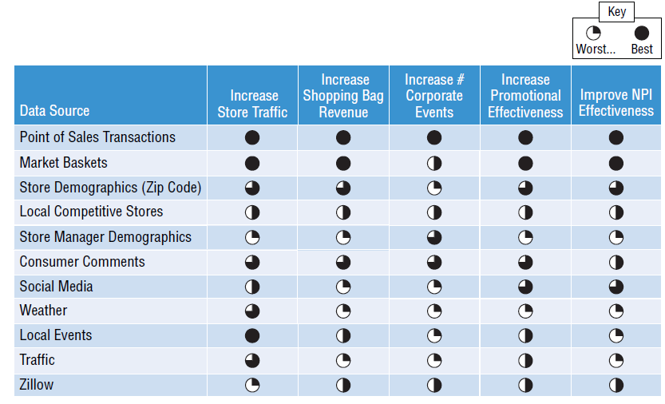
Identify and Prioritize Data Sources
Business value of potential data sources
Source: Schmarzo (2016): Big Data MBA, p. 49.

Slide 90
The Four Layers of Big Data (II)
4. Data Output Layer
Data Storage Layer
This is where Big Data is stored, once it is gathered from the sources. As the volume of data stored has started to explode‚ new database technologies have been developed — such as NoSQL database systems.
3. Data Processing/ Analysis Layer
2. Data Storage Layer
1. Data Source Layer
Source: http://de.slideshare.net/BernardMarr/140228-big-data-slide-share/3-The_basic_idea_behind_the

Slide 91
The Four Layers of Big Data (III)
4. Data Output Layer
Data Processing/Analysis Layer
When you want to use the data you have stored to ﬁnd out something useful, you will need to process and analyze it.
3. Data Processing/ Analysis Layer
2. Data Storage Layer
1. Data Source Layer
Source: http://de.slideshare.net/BernardMarr/140228-big-data-slide-share/3-The_basic_idea_behind_the

Slide 92
The Four Layers of Big Data (IV)
Data Output Layer
This is how the insights gleaned through the analysis is passed on to the people who can take action to benefit from them.
4. Data Output Layer
3. Data Processing/ Analysis Layer
2. Data Storage Layer
1. Data Source Layer
Source: http://de.slideshare.net/BernardMarr/140228-big-data-slide-share/3-The_basic_idea_behind_the

Slide 93
From Data Warehouse to Data Lake
Instead of recording millions of transactions, todays organizations are recording billions of interactions. Companies are capturing more and more data that can open business opportunities and unlock new sources of value for organizations.
Companies are not able to store this data in data warehouses because it is of high volume, mostly raw and often not structured. As consequence, data lakes have emerged as an alternative approach. The intent is to capture enterprise data and load it in its raw form into a centralized, large, and inexpensive storage system.
In shifting from data warehouses to data lakes, it became important to decouple data movement from data transformation. Data movement (the "E" and "L" of ETL) is an operational task. Data transformation (the "T" of ETL) is a content-based, analytic-facing task that requires an understanding both of the data and how it's to be used.
A clean separation between data movement and data transformation has the benefits of less friction because the instance loading the data isn't responsible for transforming it.
Source: Trifacta: EOL for ETL?
Notes:
The front-end of the above analytics architecture remains relatively unchanged for casual users, who continue to use reports and dashboards running against dependent data marts (either physical or virtual) fed by a data warehouse.
This environment typically meets much of the information needs of the organization, which can be defined up-front through requirements-gathering exercises. Predefined reports and dashboards are designed to answer questions tailored to individual roles within the organization.
Ad hoc needs of casual users can also be serviced by the traditional data warehouse and data mart architecture. However, the interactive reports and dashboards rely on the IT department or “super users”—tech-savvy business colleagues—to create ad hoc reports and views on their behalf.
Search-based exploration tools that allow users to type queries in plain English and refine their search using facets or categories is one of several ways to allow more business users access to the data without being so sophisticated.
One new addition to the casual user environment are dashboards powered by streaming/CEP engines (real-time reports). While these operational dashboards are primarily used by operational analysts and workers, many executives and managers are keen to keep their fingers on the pulse of their companies’ core processes by accessing these “twinkling” dashboards directly or, more commonly, receiving alerts from these systems.

Slide 94
The Data Lake
A data lake is a method of storing data within a system in its natural format, that facilitates the collocation of data in various schemata and structural forms. The idea of data lake is to have a single store of all data in the enterprise ranging from raw data to transformed data which is used for various tasks including reporting, visualization, analytics and machine learning. [Wikipedia]
Source: https://www.pmone.com/fileadmin/user_upload/pics/other/Data_lake.jpg

Slide 95
Modern Data Analytics Architecture
Transform data for use in a proprietary data product
Source: Trifacta: EOL for ETL?
Notes:
The front-end of the above analytics architecture remains relatively unchanged for casual users, who continue to use reports and dashboards running against dependent data marts (either physical or virtual) fed by a data warehouse.
This environment typically meets much of the information needs of the organization, which can be defined up-front through requirements-gathering exercises. Predefined reports and dashboards are designed to answer questions tailored to individual roles within the organization.
Ad hoc needs of casual users can also be serviced by the traditional data warehouse and data mart architecture. However, the interactive reports and dashboards rely on the IT department or “super users”—tech-savvy business colleagues—to create ad hoc reports and views on their behalf.
Search-based exploration tools that allow users to type queries in plain English and refine their search using facets or categories is one of several ways to allow more business users access to the data without being so sophisticated.
One new addition to the casual user environment are dashboards powered by streaming/CEP engines (real-time reports). While these operational dashboards are primarily used by operational analysts and workers, many executives and managers are keen to keep their fingers on the pulse of their companies’ core processes by accessing these “twinkling” dashboards directly or, more commonly, receiving alerts from these systems.

Slide 96
Logical Data Warehouse
A "logical data warehouse" provides analytical company data without first physically moving it to a physical data warehouse.
As in a classic data warehouse, uniform views are provided for analysis purposes.
While the data in the classic data warehouse comes from a "well-defined" physically uniform database, the "logical data warehouse" pulls data together from the data lake at the time of the query.
Aggregation is done in just in time. Thus, the schema of the data warehouse is just virtual.
Data Lake
Source: http://www.datavirtualizationblog.com/emergence-logical-data-warehouse/

Slide 97
Navigation
4 Predictive Analytics
4.1 Subject of Predictive Analytics
4.2 The Analytics Process
4.3 Data Preparation
4.4 Methods, Algorithms and Applications
4.4.1 Classification
4.4.2 Regression

Slide 98
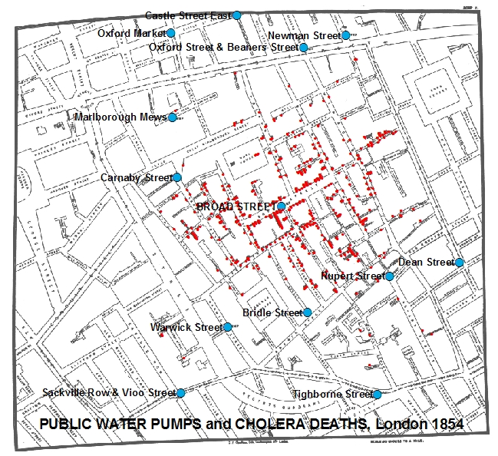
First Application of Data Analytics
Dr. John Snow's Map of the 1854 London Cholera Outbreak
Source: http://www.udel.edu/johnmack/frec480/cholera

Slide 99
Use Cases of Data Analytics - Examples
① Customer Support / Text Mining
② Demand forecasting and vehicle routing
③ Process Mining
④ Sales Forecasts for Inventory Management
⑤ Analysis of Sales Sequences for Cross-/Up-Selling / Voucher Management
⑥ Attack Prevention
⑦ Profile-based Staffing
⑧ Realtime Controlling based on Advanced Analytics
⑨ Fraud Management
⑩ Asset Management / Credit Scoring
⑪ Churn Management / Customer Segmentation
⑫ Driver-based Planning
Enter- prise Planning
⑫
⑪
Marketing Finance Accounting Controlling Human Ressources IT-Management
⑩
⑨
⑧
⑦
⑥
⑤
④
③
②
①
Sales
Procure-ment
Produc-tion
Logistics
Customer Service

Slide 100
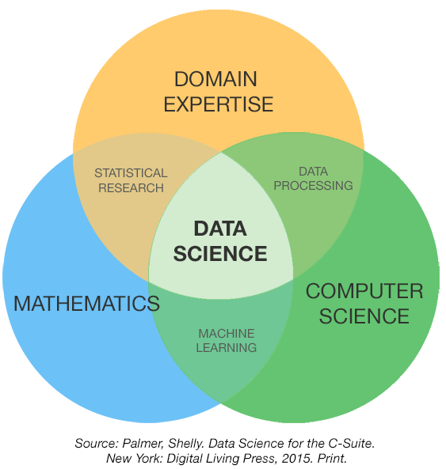
Fundamental Skills of Data Analytics

Slide 101
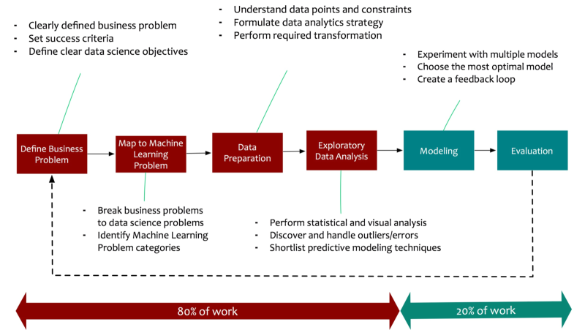
The Data Analytics Process
Source: http://www.datasciencecentral.com/profiles/blogs/data-science-simplified-principles-and-process

Slide 102
Need for Knowledge about the Algorithms
The distance between using Excel and VBA for modeling in credit scoring, for example, and using machine learning algorithms and R or Python to enhance the results, is not that great, compared to the distance between someone running a packaged algorithm they don’t really understand and someone who understands the mathematical and statistical operations within an algorithm and can optimize or adapt it as needed – and do so in the context of their deep industry experience.
Source: Dataiku - Data Science for Banking and Insurance

Slide 103
Statistics vs. Machine Learning
Statistics is about finding valid conclusions about the underlying applied theory, and on the interpretation of parameters in their models. It insists on proper and rigorous methodology, and is comfortable with making and noting assumptions. It cares about how the data was collected and the resulting properties of the estimator or experiment (e.g. p-value). The focus is on hypothesis testing.
Machine Learning (ML) aims to derive practice-relevant findings from existing data and to apply the trained models to data not previously seen (prediction). It tries to predict or classify with the most accuracy. It cares deeply about scalability and uses the predictions to make decisions. Much of ML is motivated by problems that need to have answers. ML is happy to treat the algorithm as a black box as long as it works.

Slide 104
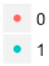

Statistical Regression vs. Machine Learning Algorithms
Traditional Regression
Real Values
Predicted Values
Decision Tree
Support Vector Machine

Slide 105
Explanation vs. Prediction (I)
Question 1: I have a headache. If I take an aspirin now, will it go away?
Question 2: I had a headache, but it passed. Was it because I took an aspirin two hours ago? Had I not taken such an aspirin, would I still have a headache?
The first case is a typical "predictive" question. You are calculating the effect of a hypothetical intervention.
The second case is a typical "explanatory" question. You are calculating the effect of a counterfactual intervention.
Notes:
Which one is Explanation, which Prediction?
counterfactual : den Tatsachen widersprechend

Slide 106
Explanation vs. Prediction (II)
Explanation:
Explanation is about understanding relationships and why certain things happen and other things not.
What we need for this is an understanding of cause and effect.
Tests of causal hypothesis are fundamental.
Measures of significance are central.
A good explanatory model may have predictive power.
Prediction:
Prediction is about anticipating and forecasting what may happen in the future.
Correlations are important in this context. Correlation does not imply causation.
Therefore, predictive models may have no real explanatory power.
To achieve robust predictive models the knowledge of causality is preferable.
Main Task is to find a model that optimally approximates reality and minimizes overfitting.
Accuracy is measured using out-of-sample data.

Slide 107

Correlation
Source: Organic Trade Association, 2011 Organic lndustry Survey, U.p. Department of Education, Ofﬁce of Special Education Programs, Data Analysis System (DANS)
Organic food sales and the rate of autism seem to have a very strong correlation‚ but no one is suggesting that one causes the other!

Slide 108
Correlation vs. Causality (I)
Correlation: Two data series behave "similar"
Causality: Principle of Cause and Effect

Slide 109


Correlation vs. Causality (II)
Correlation and Causality
Correlation but no Causality

Slide 110
Correlation vs. Causality (III)
But:
Sometimes it is better to know/predict something even if we can not explain it instead of doing nothing!
Notes:
Religion argues in this way too

Slide 111

Statistical Estimation
Source: http://www.dxbydt.com/the-size-of-your-sample

Slide 112
Navigation
4 Predictive Analytics
4.1 Subject of Predictive Analytics
4.2 The Analytics Process
4.3 Data Preparation
4.4 Methods, Algorithms and Applications
4.4.1 Classification
4.4.2 Regression

Slide 113
Definitions
A method is a composition of formalized principles that form the basis for a stringent calculation process.
An algorithm is a procedure or set of steps or rules to accomplish a task. It is usually the implementation of a method. Algorithms are used to build models.
In the given context, a model is the description of the relationship between variables. It is used to create output data from given input data, for example to make predictions.
Fitting a model means that you estimate the model using the observed data. You are using your data as evidence to help approximate the real-world mathematical process that generated the data. Fitting the model often involves optimization methods and algorithms, such as maximum likelihood estimation, to help get the parameters.
Overfitting is the term used to mean that you used a dataset to estimate the parameters of your model, but your model isn’t that good at capturing reality beyond your sampled data.
Source: Schutt/O’Neil (2013): Doing Data Science.

Slide 114
Traditional Analytics Process
validate
create
+
build
Sample
Algorithm
apply
Predictive Model
Reality

Slide 115


Example Regression - Fitting the model
Proportion of variance explained by the model.
Probability that the null hypothesis that all of the regression coefficients are equal to zero.
Probability that the null hypothesis 𝛽 = 0 is true. The coefficients are highly likely to be nonzero and therefore significant.

Slide 116

Example Regression - Testing the model
Conclusion: Model is not robust due to overfitting.

Slide 117
Data Errors and their Consequences

Slide 118
Modern Analytics Process
Training Sample
Algorithm
+
build
create
adjust
validate
Test Sample
Predictive Model
Reality
apply

Slide 119


Best Fit vs. Best Generalization
Training (Model Estimation)
Test (Model Application)
Over-fitting
Training Error
Test Error
Best Fitness
Best Generalization
Sensitivity
Sensitivity

Slide 120

Over- and Underfitting
Training
Test
Training
Test
Training
Test
Underfitting
(model is too simple, both training and test errors are large)
Good Fitting
Overfitting
(model is too complex, training error is small, but test error is large)
Due to the problem of overfitting, the main goal is to maximize the prediction quality and not to fit the data that is used for the model estimation as well as possible. This is equivalent to minimizing the risk that the model will have weak predictive ability.
Notes:
Fibonacci Sequence: 0, 1, 1, 2, 3, 5, 8, 13, 21, 34, 55
Measurement Error: 0, 1, 1, 2, 3, 6, 8, 13, 20, 34, 55

Slide 121
The Bias-Variance Tradeoff
The prediction error is influenced by three components:
Error = Bias + Variance + Noise
Bias is the inability of the used method to learn the relevant relations between the inputs and the outputs. It reflects the method quality, e.g. if a method only produces linear models.
Variance is represents the deviation resulting from the sensitivity of the created model to small fluctuations in the data.
Typically, there is a tradeoff between bias and variance.
Noise is everything that arises from random variations in the data. It cannot be controlled.
Low Variance High Variance
High Bias Low Bias

Slide 122
Summarizing: Statistics vs. Data Analytics
Statistics
Goals: Explanation, Forecasting
Methods: Statistical Methods
Process: Data Method Model generalizable?
Data Analytics
Goals: Forecasting, Finding Structures
Methods: Statistical Methods, Machine Learning, Artificial Intelligence
Process: Training Data Method Model Test Data
(Statist. Tests)
recalibrate

Slide 123
Which Method should I choose?
The choice of the method of data analysis depends on the one hand on the scope of application, but on the other hand on the interrelationships of the data to be analyzed.
In the Big Data area, data spaces are often highly-dimensional, making it difficult to visualize the interrelationships.
For this reason, the choice of the method can often not be made ex ante. In these cases, different methods are competitively tried to select the most suitable one.

Slide 124
Linear World
Class 1 e.g. creditworthy
Class 2 e.g. not creditworthy
Appropriate Methods:
Regression
Linear Discriminant Analysis

Slide 125
Quadratic World
Class 1
Class 2
Appropriate Methods:
Quadratic Discriminant Analysis
Support Vector Machines
Neural Networks

Slide 126
Nonlinear World (Type 1)
Class 1
Class 2
Appropriate Methods:
Support Vector Machines
Neural Networks

Slide 127
Nonlinear World (Type 2)
Class 1
Class 2
Appropriate Methods:
Support Vector Machines
Neural Networks

Slide 128
Nonlinear World (Type 3)
Class 1
Class 2
Appropriate Methods:
Decision Trees
Neural Networks

Slide 129
Nonlinear World (Type 4)
Class 1
Class 2
Appropriate Methods:
k-Nearest Neighbors
Naive Bayes

Slide 130

The Data Analytics Process - Technical View
Source: http://blogs.msdn.microsoft.com/martinkearn/2016/03/01/machine-learning-is-for-muggles-too/

Slide 131
Navigation
4 Predictive Analytics
4.1 Subject of Predictive Analytics
4.2 The Analytics Process
4.3 Data Preparation
4.4 Methods, Algorithms and Applications
4.4.1 Classification
4.4.2 Regression

Slide 132

Data Preparation and Enrichment
The data collection and preparation phase is the most labor-intensive one, consuming on average between 60-80% of a data scientist’s time. It’s critical therefore to select a tool that can automate or at least speed the workflows associated with data preparation.
Source: 2016 Dataiku, Inc.

Slide 133
Data Cleaning
Proof of correctness of the data • examine for irregular outliers (e.g. Age=236) • examine for typographical errors (e.g. Frankfrut) • examine for different writing styles (e.g. behavior/behaviour) • …
Handling missing values
all objects having missing values (rowwise)
eliminate
variables having missing values first, then remaining objects
with the true values
with mean values
imputing by estimated values (e.g. using k-Nearest Neighbors)
replace

Slide 134
Missing Values Strategies
Initial Situation
Variable 1 | Variable 2 | Variable 3 | Variable 4 | Variable 5
8.95 | 0.99 | NA | 370.53 | -34.97
NA | NA | 168.02 | 617.46 | -99.49
18.38 | 0.48 | 58.06 | 1177.66 | -44.21
16.10 | NA | 35.39 | NA | 77.35
23.14 | NA | 230.44 | 408.97 | -71.79
24.77 | 0.92 | 206.83 | NA | 46.13
20.72 | NA | 228.74 | 659.37 | -67.77
15.52 | 0.04 | 22.46 | NA | 36.63
Smart Strategy
Variable 1 | Variable 2 | Variable 3 | Variable 4 | Variable 5
8.95 | 0.99 | NA | 370.53 | -34.97
NA | NA | 168.02 | 617.46 | -99.49
18.38 | 0.48 | 58.06 | 1177.66 | -44.21
16.10 | NA | 35.39 | NA | 77.35
23.14 | NA | 230.44 | 408.97 | -71.79
24.77 | 0.92 | 206.83 | NA | 46.13
20.72 | NA | 228.74 | 659.37 | -67.77
15.52 | 0.04 | 22.46 | NA | 36.63
Step 1:
Stupid Strategy
Variable 1 | Variable 2 | Variable 3 | Variable 4 | Variable 5
8.95 | 0.99 | NA | 370.53 | -34.97
NA | NA | 168.02 | 617.46 | -99.49
18.38 | 0.48 | 58.06 | 1177.66 | -44.21
16.10 | NA | 35.39 | NA | 77.35
23.14 | NA | 230.44 | 408.97 | -71.79
24.77 | 0.92 | 206.83 | NA | 46.13
20.72 | NA | 228.74 | 659.37 | -67.77
15.52 | 0.04 | 22.46 | NA | 36.63
Variable 1 | Variable 3 | Variable 5
8.95 | NA | -34.97
NA | 168.02 | -99.49
18.38 | 58.06 | -44.21
16.10 | 35.39 | 77.35
23.14 | 230.44 | -71.79
24.77 | 206.83 | 46.13
20.72 | 228.74 | -67.77
15.52 | 22.46 | 36.63
Step 2:

Slide 135
Sampling
A population can be defined as including all people or items with the characteristic one wishes to understand.
Sampling is about to find a representative subset of that population.
Data represents the traces of the real-world processes, and exactly which traces we gather are decided by our sampling method.
There are two sources of randomness and uncertainty:
the randomness and uncertainty underlying the process itself, and
the uncertainty associated with the underlying sampling method.

Slide 136
Sampling in Times of Big Data
Question:
Is there any need for sampling in times of Big Data? Why not "N=ALL"?
Answer:
Data is not objective! Data does not speak for itself. Data is just a quantitative echo of the events of our society.
Examples:
When analyzing the probability of customers terminating the relationship, a very small proportion of terminating customers (e.g. 0.2%) on the whole may result in a bias.
When analyzing political attitudes via social media data, there might be a bias if people with specific attitudes are posting more frequently.

Slide 137
Reasons for Sampling
The volume of data is too large to capture and process
Design the analytics process using a subset of the data for performance reasons. Later use the complete data set.
The data set doesn't perfectly represent the target population.
The data set is imbalanced.
Use sampling to partition into training and test data.
...

Slide 138
Popular Methods of Sampling (I)
Systematic Sampling
Simple Random Sampling
Proportional Sampling
Employees are divided into subgroups
List with names
5000 employees
For example: Choose every row with an even number
100 employees chosen at random
Equal selection at random of each group (also known as Stratified Sampling)

Slide 139
Popular Methods of Sampling (II)
Downsampling
Oversampling
Randomly reduce the size of the majority group to the size of the minority group
Randomly increase the size of the minority group to the size of the majority group (by duplicating data objects or by creating synthetic data objects)

Slide 140

Systematic Sampling
Choose every row with an even number
Yes = 1
No = 11

Slide 141
Random Sampling
Creates totally random samples
Example: 40%
Yes = 1
No = 9

Slide 142
Proportional Sampling
Creates proportional samples
Example: 40%
Yes = 2
No = 8

Slide 143
Downsampling
Creates balanced samples
Yes = 5
No = 5

Slide 144

SMOTE
SMOTE (Synthetic Minority Oversampling Technique) is an oversampling technique where the synthetic samples are generated for the minority class.
At first the total number of oversampling observations N is set up. Usually, it is selected such that the resulting class distribution is 1:1. Now, the iteration starts by first selecting a minority class instance at random. Next, the k nearest neighbors for that instance are obtained. For every neighbor calculate the difference as distance and multiply this difference by a random value between 0 and 1. Adding the result to the chosen instance creates a new synthetic instance. This is done until the number of needed instances is reached.
Source: https://github.com/minoue-xx/Oversampling-Imbalanced-Data

Slide 145
Feature Engineering
Feature engineering is the process of using domain knowledge of the data to create features that make machine learning algorithms work. If feature engineering is done correctly, it increases the predictive power of machine learning algorithms by creating features from raw data that help facilitate the machine learning process.
A feature (variable, attribute) is depicted by a column in a dataset. Considering a generic two-dimensional dataset, each observation is depicted by a row and each feature by a column, which will have a specific value for an observation:
Features can be of two major types. Raw features are obtained directly from the dataset with no extra data manipulation or engineering. Derived features are usually obtained from feature engineering, where we extract features from existing data attributes. A simple example would be creating a new feature “Age” from an employee dataset containing "Birthdate".
Columns (Features)
 | Feature 1 | Feature 2 | Feature 3
0 | 18.38 | 58.06 | -44.21
1 | 16.10 | 35.39 | 77.35
2 | 23.14 | 230.44 | -71.79
3 | 24.77 | 206.83 | 46.13
Rows (Observations)
Sources: Sarkar, D.: Understanding Feature Engineering, towardsdatascience.com and Shekhar, A.: What Is Feature Engineering for Machine Learning?, medium.com.

Slide 146
Variants of Feature Engineering
Transformation • convert features (e.g. birth date to age) • build lag structures (e.g. time-lags) • normalization / standardization / scaling
Type Conversion • if numerical type is needed, transformation of categorical into numerical data using dummy features • if categorical type is needed or more informative, discretize numerical features (e.g. income to income classes like poor and rich)
Feature Combination • create interaction features (e.g. school_score = num_schools x median_school with num_school = number of schools within 5 miles of a property and median_school = median quality score of those schools • combine categories (e.g. because they have very few observations or they would result in too many dummy features)
Feature Composition • build ratios (e.g. returns from prices) • Principal Component Analysis (Dimensionality Reduction)

Slide 147
Scaling
Most datasets contain features highly varying in magnitudes, units and range. Most machine learning algorithms have problems with this because they use distance measures or calculate gradients. The features with high magnitudes will weigh in a lot more in the distance calculations than features with low magnitudes and gradients may end up taking a long time or are not accurately calculable.
To overcome this effect, we scale the features to bring them to the same level of magnitudes. The two most discussed scaling methods are Normalization and Standardization.
Normalization typically means to rescale the values into a range of [0,1]:
Standardization typically means to rescale data to have a mean of 0 and a standard deviation of 1 (Z scores):
If necessary scaling can be inverted:
resp.

Slide 148
Type Conversion (Encoding)
Many machine learning algorithms cannot work with categorical data directly. To convert categorical data to numbers, there exist two variants:
Label encoding refers to transforming the word labels into numerical form so that the algorithms can understand how to operate on them. Every categorical value is assigned to one numerical value, e.g. young -> 1, middle_age -> 2, old -> 3. This only works in specific situations where you have somewhat continuous-like data, e.g. if the categorical feature is ordinal.
One hot encoding is a representation of a categorical variable as binary vectors. Every categorical value is assigned to an artificial binary variable. If the corresponding categorical value occurs in a data row the value of its binary replacement is equal to 1 else 0, e.g.
It is usual when creating dummy variables to have one less variable than the number of categories present to avoid perfect collinearity (dummy variable trap).

Slide 149


Example of Feature Engineering (I)
Data sets often contain date/time features. These features are rarely useful in their original form because they only contain ongoing values. However, they can be useful for extracting cyclical factors, such as weekly or seasonal effects. Suppose, we are given a data "flight date time vs status". Then, given the date-time data, we have to predict the status of the flight.
But the status of the flight may depend on the hour of the day, not on the date-time. To analyze this, we will create the new feature "Hour_Of_Day". Using the "Hour_Of_Day" feature, the machine will learn better as this feature is directly related to the status of the flight.
Source: Shekhar, A.: What Is Feature Engineering for Machine Learning?, medium.com.

Slide 150

Example of Feature Engineering (II)
Suppose we are given the latitude, longitude and other data with the objective to predict the target feature "Price_Of_House". Latitude and longitude are not of use in this context if they are alone. So, we will combine the latitude and the longitude to make one feature.
In other cases, it might be appropriate to transform latitude and longitude into categories which reflect regions, for example

Slide 151
Example of Feature Engineering (III)
Suppose we are given a feature "Marital_Status" and other data with the objective to classify customers into "Creditworthy" and "Not_Creditworthy". In the data set the martial status has many different values, for example
single living alone
single living with his parents
married living together
married living separately
divorced
divorced but living together
registered partnerships
living in marriage-like community
widowed
...
To avoid a transformation into too many and maybe dominating dummy features, we can group the similar classes, e.g. in single, married, widowed.
If there exist some remaining sparse classes which cannot be assigned in a meaningful way they can be joined into a single "other" class.

Slide 152

Partitioning the Data
The partitioning of the data in Training and Test Data has the aim to proof if the analytical results can be generalized. The analysis (e.g. the development of a classifier) is carried out on the basis of training data. Subsequently, the results are applied to the test data. If the results are significantly worse than the training data, the model is not generalizable, which is called overfitting.
The partitioning of the data in training and test data can be carried out in the following ways:
By random/stratified/... sampling (problem with the repeatability)
according to a list
according to rules (e.g. the first/last 50 records or every twelfth)

Slide 153
Applying Training and Test Data
Source: http://www.cs.kent.edu/~jin/BigData/Lecture10-ML-Classification.pptx

Slide 154

Partitioning
Partitions into training and test data
Example: Training = 60% Test = 40%

Slide 155
Exploratory Data Analysis
In Exploratory Data Analysis (EDA), there is no hypothesis and there is no model.
People are not very good at looking at a column of numbers or a whole data table and then determining important characteristics of the data. EDA techniques have been devised as an aid in this situation.
Reasons for EDA:
gain intuition about the data
make comparisons between distributions
sanity checking (making sure the data is on the scale you expect, in the format you thought it should be)
find out where data is missing or if there are outliers
summarize the data
Exploratory data analysis is generally cross-classed in two ways. First, each method is either non-graphical or graphical. And second, each method is either univariate or multivariate.

Slide 156

Univariate Non-Graphical EDA
Non-graphical exploratory data analysis is the first step when beginning to analyze the data. This preliminary data analysis step focuses on four points:
measures of central tendency, i.e. mean and median. The median, known as 50th percentile, is more resistant to outliers.
measures of spread, i.e. variance, standard deviation, and interquartile range
the shape of the distribution
the existence of outliers
The characteristics of interest for a categorical variable are simply the range of values and the frequency of occurrence for each value.

Slide 157

Tests on Outliers
Outlier are data objects, which are clearly different from the others.
Usually, the detection of outliers is an unsupervised process, because they are not known before analyses.
In the case of numerical attributes the Interquartil Range can be used. Here, an outlier is defined if the attribute lies outside the interval
Usually, k has a value between 1.5 and 3. The bigger k, the more different the values must be to be classified as outliers.
Can be visualized by a Box-and-Whisker Plot:

Slide 158

Handling Outliers
Outlier have to be eliminated if they
would bias the analysis, e.g. if 9 persons have an age between 20 and 30 and the 10th person is 80 years old.
are erogenous data, e.g. as a result of input errors or a defect sensor.
It is not always acceptable to drop an observation just because it is an outlier. They can be legitimate observations and are sometimes interesting ones. It’s important to investigate the nature of the outlier before deciding.
In those cases where you shouldn’t drop the outlier, one option is to try a transformation. Log transformations pull in high numbers. This can reduce the impact of a single point if the outlier is an independent variable.

Slide 159



Univariate Graphical EDA
Non-graphical and graphical EDA methods complement each other, they have the same focus. While the non-graphical methods are quantitative and objective, they do not give a full picture of the data. The distribution of a variable tells us what values the variable takes and how often each value occurs.
Types of displays:
for numerical variables: Histograms, Boxplots, Quantile-normal plots, …
for categorical variables: Pie charts, Bar graphs, …

Slide 160


Multivariate Non-Graphical EDA
Multivariate non-graphical EDA techniques generally show the relationship between two or more variables in the form of either cross-tabulation for categorical variables or correlation statistics for numerical variables.

Slide 161



Multivariate Graphical EDA
Multivariate graphical EDA techniques are scatterplots for numerical variables, Barcharts for categorical variables, or Boxplots for mixed types.

Slide 162

Touring Diagram

Slide 163
Navigation
4 Predictive Analytics
4.1 Subject of Predictive Analytics
4.2 The Analytics Process
4.3 Data Preparation
4.4 Methods, Algorithms and Applications
4.4.1 Classification
4.4.2 Regression

Slide 164



Categories in Machine Learning

Slide 165

Supervised Learning
?
Classification:
„To which segment does the new object belong to?"
?
Regression:
"What is the target value of the object."

Slide 166

Unsupervised Learning
Segmentation (Clustering):
"In how many and which segments can the data be partitioned?"
Association:
"Detect the strength and the direction of relationships in my data."

Slide 167


Supervised and Unsupervised Learning
Supervised Learning:
Goal: predict a target or outcome variable
Training data where target value is known
Score to test data where value is not known
Unsupervised Learning:
Goal: detect patterns
Grouping of cases based on similarities in input values
There is no target (outcome) variable

Slide 168
Use Cases Quiz
Online Shop for Electronic products:
Management of Customer Termination (Churn Management)
Returns Management
Identify similar Regions for Advertising
Sales Forecasts for Supply and Inventory Management
Automatically assign new Products into existing Product Categories
Grouping of similar Customers
Voucher Management
Analysis of frequently sold Product Combinations
Fraud Detection
Structuring the Competitors
Analysis of Sales Sequences
...

Slide 169
Reinforcement Learning
The solution to many of the problems in our lives cannot be automated. This is not because current computers are too slow, but simply because it is too difficult for humans to determine what the program should do.
Supervised learning is a general method for training an approximator. However, supervised learning requires sample input-output pairs from the domain to be learned.
For example, we might not know the best way to program a computer to recognize an infrared picture of a tank, but we do have a large collection of infrared pictures, and we do know whether each picture contains a tank or not. Supervised learning could look at all the examples with answers, and learn how to recognize tanks in general.
Unfortunately, there are many situations where we don’t know the correct answers that supervised learning requires. For example, in a self-driving car, the question would be the set of all sensor readings at a given time, and the answer would be how the controls should react during the next millisecond.
For these cases there exist a different approach known as reinforcement learning.

Slide 170

Reinforcement Learning
The agent learns how to achieve a given goal by trial-and-error interactions with its environment by maximizing a reward.

Slide 171

AlphaGo
Go is one of the hardest games in the world for AI because of the huge number of different game scenarios and moves. The number of potential legal board positions is greater than the number of atoms in the universe.
The core of AlphaGo is a deep neural network. It was initially trained to learn playing by using a database of around 30 million recorded historical moves. After the training, the system was cloned and it was trained further playing large numbers of games against other instances of itself, using reinforcement learning to improve its play. During this training AlphaGo learned new strategies which were never played by humans.
A newer version named AlphaGo Zero skips the step of being trained and learns to play simply by playing games against itself, starting from completely random play.
Notes:
Chess 2^64 legal positions, Go 2^120!!!

Slide 172

Libratus
An artificial intelligence called Libratus has beaten four of the world’s best poker players in a grueling 20-day tournament in January 2017.
Poker is more difficult because it’s a game with imperfect information. With chess and Go, each player can see the entire board, but with poker, players don’t get to see each other’s hands. Furthermore, the AI is required to bluff and correctly interpret misleading information in order to win.
“We didn’t tell Libratus how to play poker. We gave it the rules of poker and said ‘learn on your own’.” The AI started playing randomly but over the course of playing trillions of hands was able to refine its approach and arrive at a winning strategy.

Slide 173
Types of Artificial Intelligence
Discriminative AI is designed to differentiate and classify input, but not to create new content. Examples include image or speech recognition, credit scoring or stock price prediction.
Generative AI is able to generate new content based on existing information and user specifications. This includes texts, images, videos, program code, etc. The generated content can often hardly be distinguished from human-generated content. As things stand at present, however, they are pure recombinations of learned knowledge.
Well-known examples of generative AI are language models for generating text, such as GPT-3 or GPT-4, and the chatbot ChatGPT based on them, or image generators such as Stable Diffusion and DALL-E.

Slide 174
ChatGPT
ChatGPT is a generative AI that produces human-like text and communicates with humans.
The "GPT" in ChatGPT comes from the language model of the same name, which was extended for ChatGPT with various components for communication and quality assurance.
GPT is based on a huge neural network that essentially represents the language model. While the first GPT-3 has 175 billion parameters, the newer GPT-4 already has 1 trillion parameters. Compared to GPT-3, GPT-4 is therefore more intelligent, can deal with more extensive questions and conversations and makes fewer factual errors.

Slide 175



ChatGPT - Approach
ChatGPT generates its response word by word via a sequence of probabilities, with each new word depending on the previous ones.
The most probable word is not always selected; instead, randomization takes place. This means that different variants can be created for the same task.

Slide 176

ChatGPT - Semantic Spaces (I)

Slide 177
ChatGPT - Semantic Spaces (II)

Slide 178

ChatGPT - Evaluation Component

Slide 179
Navigation
4 Predictive Analytics
4.1 Subject of Predictive Analytics
4.2 The Analytics Process
4.3 Data Preparation
4.4 Methods, Algorithms and Applications
4.4.1 Classification
4.4.1.1 K-Nearest Neighbors
4.4.1.2 Evaluating the Quality of Classification
4.4.1.3 Decision Tree Approaches
4.4.1.4 Logistic Regression
4.4.1.5 Neural Networks
4.4.1.6 Resampling
4.4.1.7 Ensemble Learning
4.4.2 Regression

Slide 180

Introductory Example
Credit-Scoring is a typical example for a classification problem. A bank wants to determine the creditworthiness of a customer.
Assume you have the age, income, and a creditworthiness category of "yes" or "no" for a bunch of people and you want to use the age and income to predict the creditworthiness for a new person.
You can plot people as points on the plane and label people with an empty circle if they have low credit ratings.
What if a new guy comes in who is 49 years old and who makes 53,000 Euro? What is his likely credit rating label?

Slide 181
Navigation
4 Predictive Analytics
4.1 Subject of Predictive Analytics
4.2 The Analytics Process
4.3 Data Preparation
4.4 Methods, Algorithms and Applications
4.4.1 Classification
4.4.1.1 K-Nearest Neighbors
4.4.1.2 Evaluating the Quality of Classification
4.4.1.3 Decision Tree Approaches
4.4.1.4 Logistic Regression
4.4.1.5 Neural Networks
4.4.1.6 Resampling
4.4.1.7 Ensemble Learning
4.4.2 Regression

Slide 182
k-Nearest Neighbors
k-Nearest Neighbors (k-NN) is an algorithm that can be used when you have a bunch of objects that have been classified or labeled in some way, and other similar objects that have not gotten classified or labeled yet, and you want a way to automatically label them.
The intuition behind k-NN is to consider the most similar other items defined in terms of their attributes, look at their labels, and give the unassigned item the majority vote. If there’s a tie, you randomly select among the labels that have tied for first.
Procedure of k-NN:
Determine parameter k (= number of nearest neighbors)
Calculate the distances between the new object and all known labeled objects.
Choose the k objects from all known labeled objects having the smallest distance to the new object as nearest neighbors.
Count the frequencies of the classes of the nearest neighbors.
Assign the new object to the most frequent class.

Slide 183
Measuring Similarity
The purpose of a measure of similarity is to compare two vectors of data, and compute a single number which evaluates their similarity.
Usually the similarity s(x,y) of two objects x and y is measured using the inverse of some distance measure d(x,y):
Euclidean distance is most often used for numerical data vectors:
with n as size of the vectors.
Note: The variables must be scaled to avoid unwanted weighting resulting from different level of measurement.

Slide 184
Unnormalized vs. Normalized
Unnormalized:
Normalized:

Slide 185
Example (I)
Data:
New Customer:
Customer | Age | Monthly | Monthly | Creditworthy
 |  | Income | Costs
A | 24 | 1800 | 1400 | yes
B | 26 | 1700 | 1300 | no
C | 30 | 2800 | 2200 | yes
D | 33 | 4200 | 3800 | yes
E | 35 | 2300 | 1800 | no
F | 39 | 3000 | 2800 | no
G | 41 | 2400 | 1600 | yes
H | 47 | 5000 | 2500 | yes
I | 53 | 4700 | 3200 | no
J | 59 | 2100 | 1700 | yes

Slide 186
Example (II)
1. k = 5 is chosen
2. Calculate the distances (Normalization and then Euclidian Distance)
Customer | Age | Monthly Income | Monthly Costs | Creditworthy | Distance
A | 0.0000 | 0.0303 | 0.0400 | yes | 0.4347
B | 0.0571 | 0.0000 | 0.0000 | no | 0.4490
C | 0.1714 | 0.3333 | 0.3600 | yes | 0.1726
D | 0.2571 | 0.7576 | 1.0000 | yes | 0.8922
E | 0.3143 | 0.1818 | 0.2000 | no | 0.2010
F | 0.4286 | 0.3939 | 0.6000 | no | 0.4482
G | 0.4857 | 0.2121 | 0.1200 | yes | 0.3090
H | 0.6571 | 1.0000 | 0.4800 | yes | 0.8167
I | 0.8286 | 0.9091 | 0.7600 | no | 0.9855
J | 1.0000 | 0.1212 | 0.1600 | yes | 0.8096
X | 0.2286 | 0.3636 | 0.2000 | ?

Slide 187
Example (III)
3. Choose the k nearest neighbors
4. Count the numbers of class members
3 x yes; 2 x no
5. Assign object to most frequent class
Customer is creditworthy!
Customer | Age | Monthly Income | Monthly Costs | Creditworthy | Distance
A | 0.0000 | 0.0303 | 0.0400 | yes | 0.4347
C | 0.1714 | 0.3333 | 0.3600 | yes | 0.1726
E | 0.3143 | 0.1818 | 0.2000 | no | 0.2010
F | 0.4286 | 0.3939 | 0.6000 | no | 0.4482
G | 0.4857 | 0.2121 | 0.1200 | yes | 0.3090
X | 0.2286 | 0.3636 | 0.2000 | ?

Slide 188
Creation and Use of Models
Training Set
Test Set
use as neighbors database
validate suitability for use
k-Nearest Neighbors
Analytics Layer
apply to new instances
Business Layer
New Customers/ Transactions/ ...

Slide 189

Calculating Accuracies
Training Set Test Set
+
+
-
+
-
-
+
-
+
-
-
+
-
-
+
+
+
-
+
-
real
predicted
+
-
-
+
-
+
+
-
+
-
-
+
+
-
+
-
+
-
+
+
The training set is used to calculate the classifier model.
The accuracy of the training set indicates the goodness of fit of the model.
The test set is used to evaluate the classifier model.
The accuracy of the test set indicates the robust-ness/predictability of the model.
Accuracy = $\frac{\#Match}{\#All}$

Slide 190
Determining Parameter k
k | Accuracy
1 | 0.720
2 | 0.685
3 | 0.740
4 | 0.745
5 | 0.770
6 | 0.740
7 | 0.750
8 | 0.750
9 | 0.765
10 | 0.760
1. Split the original labeled dataset into training and test data.
2. Pick an evaluation metric. Misclassification rate or accuracy are good ones.
3. Run k-NN a few times, changing k and checking the evaluation measure.
4. Optimize k by picking the one with the best evaluation measure.

Slide 191
Navigation
4 Predictive Analytics
4.1 Subject of Predictive Analytics
4.2 The Analytics Process
4.3 Data Preparation
4.4 Methods, Algorithms and Applications
4.4.1 Classification
4.4.1.1 K-Nearest Neighbors
4.4.1.2 Evaluating the Quality of Classification
4.4.1.3 Decision Tree Approaches
4.4.1.4 Logistic Regression
4.4.1.5 Neural Networks
4.4.1.6 Resampling
4.4.1.7 Ensemble Learning
4.4.2 Regression

Slide 192

Evaluating the quality of Classification (I)
True positives (TP), true negatives (TN), false positives (FP), and false negatives (FN), are the four different possible outcomes of a single prediction for a two-class case. A false positive is when the outcome is incorrectly classified as "yes", when it is in fact "no". A false negative is when the outcome is incorrectly classified as negative, when it is in fact positive. True positives and true negatives are obviously correct classifications.
Confusion Matrix:

Slide 193

Evaluating the quality of Classification (II)
Test metrics are used to assess how accurately the model predicts the known values:
Most classification algorithms pursue to minimize the misclassification rate. They implicitly assume that all misclassification errors cost equally. In many real-world applications, this assumption is not true. Cost-sensitive learning takes costs, such as the misclassification cost, into consideration. Using costs, the error rate can be calculated via:
$$accuracy=\frac{TN+TP}{TP+FP+TN+FN}$$
$$misclassification rate =\frac{FN+FP}{TP+FP+TN+FN}=1−accuracy$$
$$cost sensitive misclassification rate =\frac{FN∙C_{FN}+FP∙C_{FP}}{TP+FP+TN+FN}$$

Slide 194




Evaluating the quality of Classification (III)
Misclassification rate and accuracy can be misleading, for example in the case of imbalanced samples. Extreme case:
yes no
yes 1000 3
no 45 2
For problems like, this additional measures are required to evaluate a classifier.
Sensitivity (true positive rate, recall) measures the proportion of positives that are correctly identified as such. Specificity (true negative rate) measures the proportion of negatives that are correctly identified as such.
Using both measures, we can compute the Balanced Accuracy
$$\frac{1000+2}{1000+45+3+2}=0.954$$
$$sensitivity =\frac{TP}{TP+FN}$$
$$specificity =\frac{TN}{TN+FP}$$
$$balanced accuracy=\frac{sensitivity+specificity }{2}$$

Slide 195
Problem of Imbalancing and Accuracy
Assume the following case: A credit card company wants to create a fraud detection system to include it into their transactional systems. The outcomes should be "Accept" (Y) and "Reject" (N). Because fraud rarely occurs, the data set consists of 320 observations for Y and 139 for N. They are partitioned into training and test set. Finally, the model is trained and tested.
Because of the majority of the Y class, the training process concentrates on these cases because their correct classification promises the highest accuracy.
The results of the test of the model is consequently:
N Y
N 21 32
Y 6 94
Thus, the model is blind for the N cases. But these are the ones of primary interest for the company.

Slide 196



Evaluating the quality of Classification (IV)
Precision measures the proportion of predicted positives who are true positives. A precision of 0.5 means that whenever the model classifies a positive, there is a 50% chance of it really being a positive.The higher the precision the smaller the number of false positives.
Recall measures the percentage of positives the model is able to catch. It is defined as the number of true positives divided by the total number of positives in the dataset. A recall of 50% would mean that 50% of the positives had been predicted as such by the model while the other 50% of positives have been missed by the model.
$$precision =\frac{TP}{TP+FP}$$
$$recall =\frac{TP}{TP+FN}$$
Source: Wikipedia

Slide 197

Evaluating the quality of Classification (V)
The F1 Score can be interpreted as the weighted average of both precision and recall. The main idea of the F1 Score is to strike a balance between both precision and recall and measure it in a single metric.
A F1 score reaches its best value at 1 (perfect precision and recall) and worst at 0.
It is commonly used in cases of high class imbalance.
$$F1=2∗\frac{precision∗recall }{precision+recall}$$

Slide 198
Creation and Use of Models
Training Set
Test Set
create
validate
Model
Analytics Layer
use
Business Layer
New Customers/ Transactions/...

Slide 199
Navigation
4 Predictive Analytics
4.1 Subject of Predictive Analytics
4.2 The Analytics Process
4.3 Data Preparation
4.4 Methods, Algorithms and Applications
4.4.1 Classification
4.4.1.1 K-Nearest Neighbors
4.4.1.2 Evaluating the Quality of Classification
4.4.1.3 Decision Tree Approaches
4.4.1.4 Logistic Regression
4.4.1.5 Neural Networks
4.4.1.6 Resampling
4.4.1.7 Ensemble Learning
4.4.2 Regression

Slide 200
Which one is better?
yes
no
50
50
yes
no
50
50
≥1000
<1000
<25
≥25
Income
Age
yes
no
30
20
yes
no
20
30
yes
no
10
42
yes
no
40
8

Slide 201















Introductory Example
yes
no
Customer
<30,000
≥30000
<30
≥30
income
age
<42
≥42
age
yes
no
university degree
Respond to Advertisement
no
yes
yes
no
house owner
yes
no
children
Notes:
To choose the relevant features, you can apply several methods and after this you may train a selection model using for example logistic regression. The whole process would be very time-consuming and even costly. As an alternative, you can apply a decision tree algorithm which is a stepwise or recursive classification mechanism.
Proportions in the leafs can be interpreted as probabilities.

Slide 202
Decision Trees (I)
Decision trees belong to the hierarchical methods of classification. They analyze step-by-step (recursive partitioning).
A decision tree consists of nodes and borders. The topmost node (without any parent node) is called "root". A node without a child node is called "leaf". Nodes that have parent and child nodes are called "interior nodes". The interior nodes represent the splitting of the included object sets. An interior node has at least two child nodes (sons). If every interior node has exactly two child nodes, the tree is called a "binary tree".
A decision tree method starts at the root, which includes all objects. The different features are compared (with an adequate measure) regarding their suitability of classification. The most appropriate feature determines the branching of the current set of objects: regarding this feature, the current set of objects is divided into disjoint subsets (partitioning). This method is now used recursively to the created child nodes (subsets).

Slide 203

Decision Trees (II)
Graphically, decision tree models divide the dataspace in a large number of subspaces and search for the variables which are able to split the dataspace with the greatest homogeneity. We can think of the decision tree as a map of different path. For a distinct combination of predictor variables and their observed values, we would enter a specific path, which gives the classification in the leaf of the decision tree.
The decision tree approach does not require any assumption about the functional form of variables or distributions. Furthermore in contrast to parametric models like linear regressions, the decision tree algorithm can model multiple structures as well as complex relationships within the data, which would be difficult to replicate in a linear model.

Slide 204

Decision Trees (III)
Source: http://iopscience.iop.org/article/10.1088/1749-4699/5/1/015004

Slide 205
Overview of important Decision Tree Methods
Name | CART | ID3 | C5.0 | CHAID | Random Forests
Idea | Choose the attribute with the highest information content | One of the first methods from Quinlan; uses the concept of information gain | Like ID3 based on the concept of information gain | Choose the attribute that is most dependent from the target variable | Construct many trees with different sets of features and samples (randomly). Result by voting.
Measure used | Gini-Index | Information gain (entropy) | Ratio of information gain | Chi-square split | optional, mostly Gini-Index
Type of Splitting | binary | complete, pruning | complete, pruning | complete, pruning | complete

Slide 206
Introductory Example
features
class variable

Slide 207
Splitting with Entropy in ID3
ID3 uses the entropy as a measure for the impurity of a node t:
where p_{i} = relative frequency of cases in a node, that belong to a class i
Attribute Wind:
light: 6 x yes, 2 x no
strong: 3 x yes, 3 x no

Slide 208
Calculating the Information Gain
The information gain is a measure, that shows (by combination of the entropies) the appropriateness of an attribute for splitting:
where m = number of values (here two: light, strong), t_{i} = number of data sets with strong or light wind (8 resp. 6), t = total number of data sets (14) and entropy(t) = entropy before splitting.
light
wind
strong

Slide 209

Decision using ID3
Information gain (outlook) = 0.246
Information gain (humidity) = 0.151
Information gain (wind) = 0.048
Information gain (temperature) = 0.029
We choose the attribute with the largest information gain (here: outlook) for the first splitting.
As solution we obtain the following tree:

Slide 210
Decision using C5.0
ID3 tends to favor attributes that have a large number of values, resulting in larger trees. For example, if we have an attribute that has a distinct value for each record, then the entropy is 0, thus the information gain is maximal.
To compensate for this, C5.0 is a further development that uses the information gain ratio as a splitting criterion:
In the case of our example the GainRatio of Windy is
and the GainRatio of Outlook is

Slide 211
Handling Numerical Attributes
Numerical attributes are usually splitted binary. In contrast to categorical attributes many possible splitting points exist .
The splitting point with the highest information gain is looked for. For this, the potential attribute is sorted according to its values first and then all possible splitting point and the corresponding information gains are calculated. In extreme cases there exists n-1 possibilities.
Test the splitting point temperature = 71.5:
temperature < 71.5: 4 x yes, 2 x no
temperature > 71.5 : 5 x yes, 3 x no
We calculate:

Slide 212
The CART Algorithm
The CART algorithm (Classification And Regression Trees) constructs trees that have only binary splits. Like C5.0, it is able to handle categorical and numerical attributes.
As a measure for the impurity of a node t, CART uses the Gini Index. In the case of two classes the Gini Index is defined as:
Gini(t)
where p_{i} = relative frequency of cases in a node, that belong to a class i, i=1,2.
A node t is splitted by the attribute that minimizes:
0,5
0
0,5
1
p_{i}
This is equivalent to:

Slide 213
Splitting in CART
Attribute Wind:
light: 6 x yes, 2 x no
strong: 3 x yes, 3 x no
resulting in:

Slide 214
Coherence between Entropy and Gini Index
Impurity
0,5
Entropy
Gini Index
0
0
1
p_{i}
Remark: Entropy has been scaled from (0, 1) to (0, 0.5)!

Slide 215

Overfitting (I)
Most decision tree algorithms partition training data until every node contains objects of a single class, or until further partitioning is impossible because two objects have the same value for each attribute but belong to different classes. If there are no such conflicting objects, the decision tree will correctly classify all training objects.
If tree performance is measured from the number of correctly classified cases it is com-mon to find that the training data gives an over-optimistic guide to future performance,
i.e. with new data. A tree should exhibit generalization, i.e. work well with data other than those used to generate it. When the tree grows during training it often shows a decrease in generalization. This is because the deeper nodes are fitting noise in the training data not representative over the entire universe from which the training set was sampled. This is called 'overfitting'.
training data
new data
optimum tree size
Overfitting can be avoided by pruning the tree so that this will improve generalization. This can be done by using a stopping criterion that prevents some sets of training cases from being subdivided (prepruning), or by removing some of the structure of the tree after it has been produced (postpruning).

Slide 216

Overfitting (II)
Good classifier
The Iearner overfits to correctly classify‚ the noisy data objects
Noisy or dirty data objects

Slide 217

Random Forest (I)
Random forest is an ensemble classifier that consists of many decision trees.
For every tree a subset of the data objects and a subset of features is randomly chosen. Then the tree is constructed usually using the Gini Index.
In the end, a simple majority vote is taken for prediction.
Algorithm:
1. Create n samples from the original data. Frequent sample size is 2/3.
2. For each of the samples, grow a tree, with the following modification: at each node, rather than choosing the best split among all predictors, randomly sample m* of the m predictors and choose the best split from among those variables.
3. Predict by aggregating the predictions of the n trees (majority votes).

Slide 218

Random Forest (II)
Voting-Principle of Random Forest:
To avoid overfitting effects, the size and the depth of the trees can be restricted.
Tree 1
Tree 2
Tree n
Class 1
Class 2
Class 2
Majority Voting
Class 2

Slide 219
Navigation
4 Predictive Analytics
4.1 Subject of Predictive Analytics
4.2 The Analytics Process
4.3 Data Preparation
4.4 Methods, Algorithms and Applications
4.4.1 Classification
4.4.1.1 K-Nearest Neighbors
4.4.1.2 Evaluating the Quality of Classification
4.4.1.3 Decision Tree Approaches
4.4.1.4 Logistic Regression
4.4.1.5 Neural Networks
4.4.1.6 Resampling
4.4.1.7 Ensemble Learning
4.4.2 Regression

Slide 220


Introductory Example
…
users
websites (features)
1=visited
0=not visited
ad (target)
1=clicked
0=not clicked
Giant sparse matrix!
One matrix for every ad!
Notes:
Giant sparse matrix! A sparse matrix is a matrix in which most of the elements are zero.
One matrix for every ad!
Can be solved by Naïve Bayes! Looking for an alternative

Slide 221
Why not classical linear regression?
It is possible to implement a linear regression on such a dataset where Y={0,1}.
Problems:
The predicted values of the linear model can be greater than 1 or less than 0
ε is not normally distributed because Y takes on only two values
The error terms are heteroscedastic (the error variance is not constant for all values of X)
Y
1
0
X
Source: Bichler (2015): Course Business Analytics, TU München

Slide 222


Logistic regression (I)
Logistic regression is a regression model where the dependent variable is categorical. The classical logistic regression is a binary classifier, where the dependent variable has two states. The output of a logistic regression model ranges between 0 and 1.
Logistic regression uses the logistic function (or Sigmoid function) because it can take an input with any value from negative to positive infinity, whereas the output always takes values between zero and one and hence is interpretable as a probability.
It is defined as:
$$F(t)=\frac{1}{1+e^{−t}}$$

Slide 223


Logistic regression (II)
If we set
the logistic function can now be written as:
We interpret F(x) as the conditional probability that the class attribute has the value 1 with the given input vector x.
$$t=β_{0}+β′x$$
$$F\left(x\right)=P\left(y=1 | x\right)=\frac{1}{1+e^{−\left(β_{0}+β^{′}x\right)}}$$
The coefficients ß₀ and ß can be estimated via Maximum Likelihood Estimation.
The parameter ß₀ represents the unconditional probability of "Y=1" knowing nothing about the feature vector x.
The parameter vector β defines the slope of the logit function. It determines the extent to which certain features contribute for increased or decreased likelihood to "Y=1".
The output of a logistic model is a probability. To use this for classification purposes:
If the predicted probability is > 0.5 the label is 1
and otherwise 0.
Notes:
odd = Chance

Slide 224
Navigation
4 Predictive Analytics
4.1 Subject of Predictive Analytics
4.2 The Analytics Process
4.3 Data Preparation
4.4 Methods, Algorithms and Applications
4.4.1 Classification
4.4.1.1 K-Nearest Neighbors
4.4.1.2 Evaluating the Quality of Classification
4.4.1.3 Decision Tree Approaches
4.4.1.4 Logistic Regression
4.4.1.5 Neural Networks
4.4.1.6 Resampling
4.4.1.7 Ensemble Learning
4.4.2 Regression

Slide 225


Functionality of Human Neurons
A Look into the Nervous System
Design of a Neuron

Slide 226
An Easy Example (I)
x₁
f(x) = Activation function
e.g.
where t = Stimulus threshold
f(x)
x₂
Output Neuron
Input Neurons

Slide 227
An Easy Example (II)
x₁
w₁
f(x) = Activation function
e.g.
where t = Stimulus threshold
f(x)
x₂
w₂
Output Neuron
Input Neurons

Slide 228

Functionality of a Neuron
Neuron

Slide 229

The Perceptron
For the case of n inputs, we can rewrite the neuron's function to
with b = -t. b is known as the perceptron's bias. The result of this function would then be fed into an activation function to produce a labeling
This results in a linear classifier. Finally, we have to pick a line that best separates the labeled data. The training of the perceptron consists of feeding it multiple training samples and calculating the output for each of them. After each sample, the weights w are adjusted in such a way so as to minimize the output error, defined for example as accuracy or MSE.
Source: http://www.toptal.com/machine-learning/an-introduction-to-deep-learning-from-perceptrons-to-deep-networks

Slide 230
The Multilayer Perceptron
The single perceptron approach has a major drawback: it can only learn linear functions. To address this problem, we’ll need to use a multilayer perceptron, also known as feedforward neural network. Here, we add layers between the input and the output layer, so-called hidden layers. The hidden layer is where the network stores it's internal abstract representation of the training data.
Input Layer
Hidden Layer 1
Hidden Layer 2
Output Layer
Input Neurons: receive signals from the outer world.
Hidden Neurons: have an internal representation of the outer world.
Output Neurons: pass signals to the outer world.

Slide 231
Types of Activation Functions
linear
function
step
function
signum function
f(x) = x
A linear composition of linear functions is still just a linear function, so most neural networks use non-linear activation functions:
tangens hyperbolicus
logistic function (sigmoid)
relu function
f(x) = tanh(x)

Slide 232
Design of a Multilayer Perceptron
Attribute₁
I₁
W_{1,11}
H₁₁
W_{2,11}
H₂₁
W_{1,12}
W_{2,12}
W_{1,1n}
W_{1,21}
W_{2,1n}
W_{2,21}
W_{3,1}
Attribute₂
I₂
W_{1,22}
H₁₂
W_{2,22}
H₂₂
W_{3,2}
O
W_{1,2n}
W_{2,2n}
.
.
.
.
.
.
.
.
.
W_{1,n1}
W_{1,n2}
W_{2,n1}
W_{2,n2}
W_{3,n}
Attribute_{n}
I_{n}
W_{1,nn}
H_{1n}
W_{2,nn}
H_{2n}
Input
Layer
Hidden
Layers
Output
Layer

Slide 233
Backpropagation
The Backpropagation algorithm is used for calculating the weights. In a training phase, the weights are iteratively calculated using training data sets in such a way that the difference between the calculated and the expected (true) results is minimized. Because the simultaneous calculation of all weights is not possible, they must be found via a learning process. The backpropagation algorithm looks for the minimum of the error function in weight space using the method of gradient descent.
The procedure in principle:
(1) Define the initial weights
(2) Put the training set into the input layer
(3) Calculate the result (value of the output layer) via successive processing one layer after the other
(4) Compare the output values and target values and calculate the difference
(5) Iterate steps (2) to (4) for every training set
(6) Calculate the total error. Adjust the weights beginning with the output layer towards the input layer (backpropagation)
(7) Iterate steps (2) to (6) until the total error reaches the defined error-level or the number of maximum iterations is reached.

Slide 234

Adjusting the Weights (I)
The error of a training set i is calculated using the quadratic deviation between the values o_{ij} of the neurons of the output layer and their corresponding true values t_{ij}.
The sum of the errors of all h training objects is the total error value E:

Slide 235


Adjusting the Weights (II)
The function E has to be minimized. Because it depends on the output neurons o_{j}, it automatically depends on their weights to the precedent layer(s):
Thus, the weights have to be found where E is minimal.
Examples of Error functions with two weights:
E
E
w₂
w₂
w₁
w₁

Slide 236

Adjusting the Weights (III)
To minimize the error (cost) function E the backpropagation algorithm uses the method of gradient descent. This method searches those weights, where the vector containing the partial first derivatives of the error function (gradient) is equal to the zero vector (minimum):
To adjust the weight w_{ij}, which connects neurons i to j, the formula is:
where a represents a predefined learning rate, which defines the step length of each iteration in the negative gradient direction and x_{i} denote the output value of neuron i.
The adjusted weight is then computed via
E

Slide 237
Principle of Gradient Descent (I)
Gradient descent is used to find the minimum of the error function. It works iterative. In an 1-dimensional world, we define the error by
The error function is at minimum if the error is equal to zero.
The prediction is the result of a combination of input and weight
The weight as the dynamic component is now adjusted until the error is at minimum. Starting with an initial weight, gradient descent jumps step by step into the minimum by adjusting the weight. The adjustment is done by calculating the direction and the amount for a step via
Now, the weight is adjusted via
After repeating this several times, the minimum is reached.

Slide 238
Principle of Gradient Descent (II)
The formula
represents the derivative of the error to the weight.
A derivative is a term that is calculated as the slope (or gradient) of a graph at a particular point. The slope is described by drawing a tangent line to the graph at the point. So, if we are able to compute this tangent line, we might be able to compute the desired direction to reach the minima.
Since the weight only indirectly affects the error, the chain rule must be applied

Slide 239
Principle of Gradient Descent (III)
Gradient Descent isn't perfect. When the gradients are too big we might overshoot so much that we're even farther away than we started
This problem is destructive because overshooting this far means we land at an even steeper slope in the opposite direction. This causes us to overshoot again even farther.
If the gradients are too big, we can make them smaller. We do this by multiplying them by a single number between 0 and 1 (such as 0.01). This fraction is typically named alpha.
Thus, the adjustment of the weights is done by
Source: https://iamtrask.github.io/2015/07/27/python-network-part2/

Slide 240


Backpropagation Step by Step (I)
In the following, the backpropagation process will be demonstrated using a simple Neural Network consisting of three layers: Input layer with two inputs neurons, one hidden layer with two neurons, and output layer with a single neuron:
Our initial weights will be: w₁ = 0.11, w₂ = 0.21, w₃ = 0.12, w₄ = 0.08, w₅ = 0.14 and w₆ = 0.15.
Source: http://hmkcode.github.io/ai/backpropagation-step-by-step

Slide 241

Backpropagation Step by Step (II)
Our dataset has one sample with two inputs and one output with the values inputs=[2, 3] and output=[1]. We will use given weights and inputs to predict the output. Inputs are multiplied by weights; the results are then passed forward to next layer:
For reasons of simplification, no activation function is used in the neurons.
Source: http://hmkcode.github.io/ai/backpropagation-step-by-step

Slide 242

Backpropagation Step by Step (III)
The network output, or prediction, is not even close to actual output. We can calculate the difference or the error as following:
Our main goal of the training is to reduce the error or the difference between prediction and actual output. Since actual output is constant, “not changing”, the only way to reduce the error is to change prediction value. The question now is, how to change prediction value?
Source: http://hmkcode.github.io/ai/backpropagation-step-by-step

Slide 243



Backpropagation Step by Step (IV)
By decomposing prediction into its basic elements we can find that weights are the variable elements affecting prediction value. To change prediction value, we need to adjust the weights:
We do this using Backpropagation. To find a local minimum of a function using gradient descent, one takes steps proportional to the negative of the gradient of the function at the current point:
For example, we update w₆:
We can picture gradient descent optimization as a hiker (the weight coefficient) who wants to climb down a mountain (cost function) into a valley (cost minimum), and each step is determined by the steepness of the slope (gradient) and the leg length of the hiker (learning rate).
Source: http://hmkcode.github.io/ai/backpropagation-step-by-step

Slide 244


Backpropagation Step by Step (V)
The derivation of the error function is evaluated by applying the chain rule:
To update w₆ we can apply the following formula:
Similarly, we can derive the update formula for w5 and any other weights existing between the output and the hidden layer:
Source: http://hmkcode.github.io/ai/backpropagation-step-by-step

Slide 245
Backpropagation Step by Step (VI)
When moving backward to update w₁, w₂, w₃ and w₄ existing between input and hidden layer, the partial derivative for the error function with respect to w₁, for example, will be as following:
We can find the update formula for the remaining weights w₂, w₃ and w₄ in the same way.
Source: http://hmkcode.github.io/ai/backpropagation-step-by-step

Slide 246


Backpropagation Step by Step (VII)
In summary, the update formulas for all weights will be:
We can rewrite the update formulas in matrices:
Source: http://hmkcode.github.io/ai/backpropagation-step-by-step

Slide 247

Backpropagation Step by Step (VIII)
With the derived formulas we can now adjust the weights:
Source: http://hmkcode.github.io/ai/backpropagation-step-by-step

Slide 248

Backpropagation Step by Step (IX)
... and use the new weights to recalculate the example:
The new prediction 0.26 is bit closer to the output than the previously predicted one 0.191. We repeat now the same process until error is close or equal to zero.
Source: http://hmkcode.github.io/ai/backpropagation-step-by-step

Slide 249
Navigation
4 Predictive Analytics
4.1 Subject of Predictive Analytics
4.2 The Analytics Process
4.3 Data Preparation
4.4 Methods, Algorithms and Applications
4.4.1 Classification
4.4.1.1 K-Nearest Neighbors
4.4.1.2 Evaluating the Quality of Classification
4.4.1.3 Decision Tree Approaches
4.4.1.4 Logistic Regression
4.4.1.5 Neural Networks
4.4.1.6 Resampling
4.4.1.7 Ensemble Learning
4.4.2 Regression

Slide 250
Problems with fixed Training and Test Samples
Training Data
Test Data
Method 1 optimize
Test data is used for two things:
Optimize the model training
Select the best model via testing the model quality
Method 2 optimize
Method 3 optimize
This contradicts the idea of independent testing and results in:
Endogenization of the test data
Selection Bias
… optimize
select
Rule: NEVER use any information from the test data for model training!

Slide 251
Addressing the Endogeneity Problem
Training Sample
Algorithm
+
build
create
adjust
validate
Validation Sample
Predictive Model
Reality
test
Test Sample
apply

Slide 252
Selection Bias
Training and test error can be highly variable, depending on precisely which observations are included in the training set and which observations are included in the validation set (Selection Bias).
Example of different OLS models as a result of different samples:
To avoid such problems, one can use so-called resampling methods.

Slide 253

Cross Validation
In Data Science cross validation can be used for model selection and adjustment. In these cases, cross validation is applied to the training data set. For every iteration, k-1 folds are used for model fitting and the remaining fold for testing the model (Validation). Every time, the quality measure (e.g. accuracy) for the validation fold is captured. At the end of this step, the average and the standard deviation of the measures are calculated. The best model is the one with the best ratio in high average and low standard deviation.
Once the model type and its optimal parameters have been selected, a final model is trained using these hyper- parameters on the full training set, and the generali- zation quality is measured on the test set.

Slide 254
Cross Validation and Grid Search
Partition the Dataset into a training and test set
For every hyperparameter value combination apply cross validation
For the combination with the highest (mean) quality calculate the final model with the complete training set
Test the final model with the test set
Compare the accurracies of training and test with regard to overfitting
Dataset
acc₁
acc₂
Calculate the mean quality of the validation folds, e.g. mean accurracy or mean F1
acc₃
acc₄
acc₅
Final model

Slide 255
Cross Validation and Grid Search in Python
GridSearchCV()
Training Set
Performs cross validation with the given hyperparameter combinations and manages the evaluation process
Using the original libraries and functions
calls
KNeighborsClassifier()
cross_val_score()
Performs cross validation
DecisionTreeClassifier()
calls
RandomForestCl…()
MLPClassifier()
…

Slide 256
Variants of Hyperparameter Optimization
1. Grid Search
Grid search sequentially goes through a preselected list of permutations for each hyperparameter and evaluates the entire search space.
2. Random Search
Random search selects values for hyperparameters at random within a predefined distribution.
While a grid search is able to find the best model given the provided options, limited compute resources means that in practice, the search space selected will have to be limited. A random search on the other hand does not iterate over the entire search space.

Slide 257

Other Variants of Cross Validation
1. Repeated Cross Validation
2. Nested Cross Validation
Different composition of the folds by random selection.
…

Slide 258

Cross Validation in Time Series
In the case of time series, classical cross validation may cause problems. If we choose random samples and assign them to either the test set or the training set we are quickly in the situation of using values from the future to forecast values in the past. But we want to avoid future-looking when we train our model. If there is a temporal dependency between observations, we must preserve that relation during training and testing.
A procedure that can be used for cross validating a time series model is cross validation on a rolling basis. Start with a small subset of data for training purpose, forecast for the later data points and then check the accuracy for the forecasted data points. The time frame for the forecast is then included as part of the next training dataset and subsequent data points are forecasted and so on.
Scikit-learn provides a class TimeSeriesSplit to do this.

Slide 259
Navigation
4 Predictive Analytics
4.1 Subject of Predictive Analytics
4.2 The Analytics Process
4.3 Data Preparation
4.4 Methods, Algorithms and Applications
4.4.1 Classification
4.4.1.1 K-Nearest Neighbors
4.4.1.2 Evaluating the Quality of Classification
4.4.1.3 Decision Tree Approaches
4.4.1.4 Logistic Regression
4.4.1.5 Neural Networks
4.4.1.6 Resampling
4.4.1.7 Ensemble Learning
4.4.2 Regression

Slide 260
Ensemble Methods
Ensemble methods use different models (created via different data sets, feature sets or methods) that are simultaneously applied to the same problem. The results are sent to an aggregating operation that produces the final result.
The most widely used classes of ensemble methods are:
Bagging
Boosting
Stacking
model 1
model 2
aggregation
result
model 3
model 4

Slide 261

Bagging
Bagging means to build multiple models from different subsamples of the training dataset and/or with different methods. The results are sent to an (weighted) voting operation that produces the final result.
Source: http://rasbt.github.io/mlxtend/ user_guide/classifier/EnsembleVoteClassifier/

Slide 262

Boosting
Boosting involves sequentially building an ensemble by training each new model instance to emphasize the training instances that previous models mispredict. Different variants exist, mostly based on tree methods. In general, any method can be used. This involves the usage of different methods at the different iterations when building the sequence of models.
Source: https://blog.bigml.com/2017/03/14/introduction-to-boosted-trees/

Slide 263

Stacking
Stacking means to build multiple models (typically of differing types) and a supervisor model that learns how to best combine the predictions of the primary models. The inputs of the supervisor model (meta-classifier) are the outputs of the other models:
Source: http://rasbt.github.io/mlxtend/ user_guide/classifier/StackingClassifier/

Slide 264

Types of Ensembles
Type 1:
consists of only a few models
each is a strong model
like few professional experts
risk of diverging opinions
risk of experts being biased to their experiences
Type 2:
consists of many models
each is a weak model as a principle
based on the idea of the wisdom of the masses
Random Forest and Gradient Boosted Trees are examples

Slide 265
Navigation
4 Predictive Analytics
4.1 Subject of Predictive Analytics
4.2 The Analytics Process
4.3 Data Preparation
4.4 Methods, Algorithms and Applications
4.4.1 Classification
4.4.2 Regression
4.4.2.1 OLS
4.4.2.2 Ridge Regression
4.4.2.3 Support Vector Regression
4.4.2.4 Neural Networks
4.4.2.5 Decision Trees
4.4.2.6 K-Nearest Neighbors

Slide 266

Predicting using Regression Methods
Example: Predicting House Prices
Function: Price = f(SquareFootage, Bedrooms, Age, SchoolRating)
Source: http://www.sclgsummit.org/uploads/presentation/8934b2d0be055a2261f5d0320f5b59bb.pdf

Slide 267
Navigation
4 Predictive Analytics
4.1 Subject of Predictive Analytics
4.2 The Analytics Process
4.3 Data Preparation
4.4 Methods, Algorithms and Applications
4.4.1 Classification
4.4.2 Regression
4.4.2.1 OLS
4.4.2.2 Ridge Regression
4.4.2.3 Support Vector Regression
4.4.2.4 Neural Networks
4.4.2.5 Decision Trees
4.4.2.6 K-Nearest Neighbors

Slide 268

Traditional OLS Regression Approach
ß₁
ß₂
ß₃
ß₄
Function:
Price = ß₀ + ß₁ * SquareFootage + ß₂ * Bedrooms + ß₃ * Age + ß₄ * SchoolRating
Source: http://www.sclgsummit.org/uploads/presentation/8934b2d0be055a2261f5d0320f5b59bb.pdf

Slide 269

Ordinary Least Squares Regression
OLS is a linear approach for predicting a quantitative response Y on the basis of a set of predictor variables X_{j}
$y_{i}=β_{0}+β_{1}∙x_{1,i}+β_{2}∙x_{2,1}+…+β_{p}∙x_{p,i}+υ_{i}=β_{0}+β′x_{i}+υ_{i}$
It assumes that there is approximately a linear relationship between X and Y.
The optimal regression line is found where the sum of squared residuals (RSS)
$$RSS=\sum_{i=1}^{n}{{υ_{i}}^{2}}=\sum_{i=1}^{n}{{\left(y_{i}−{\hat{y}}_{i}\right)}^{2}}=\sum_{i=1}^{n}{{\left(y_{i}−β_{0}−β′x_{i}\right)}^{2}}$$
is minimal. Rewriting
the parameter vector b can be calculated via: $β={(X^{′}X)}^{−1}X^{′}y$

Slide 270



Measuring the Quality of Fit (I)
Measuring the quality of fit means to measure how well the predictions of a model match the observed data.
A commonly-used measure is the Mean Absolute Error (MAE) which can be calculated for the training and the test set
A variant is the Mean Absolute Percentage Error (MAPE) which expresses the error in percent
While MAE and MAPE are easily interpretable, using the absolute value of the error often is not as desirable as squaring this difference. Depending on how you want your model to treat outliers, or extreme values, in your data, you may want to bring more attention to these outliers or downplay them.
Consequently, the most used measure in regression is the Mean Squared Error (MSE) or its variant the Root Mean Squared Error (RMSE), which is the square root of the MSE.
$MAE=\frac{1}{n}∙\sum_{i=1}^{n}{\left|y_{i}−{\hat{y}}_{i}\right|}$
$MAPE=\frac{1}{n}∙\sum_{i=1}^{n}{\left|\frac{y_{i}−{\hat{y}}_{i}}{y_{i}}\right|}$
$MSE=\frac{1}{n}∙\sum_{i=1}^{n}{{\left(y_{i}−{\hat{y}}_{i}\right)}^{2}}$

Slide 271



Measuring the Quality of Fit (II)
An alternative measure is R², which calculates the proportion of variance explained. It indicates how much better the model predicts compared to the mean $\overline{y}$ as a naïve predictor
As the formula shows, R² is a normalized version of MSE. Technically, it is the MSE divided by a constant that is case-dependent but the same for all the comparative models IF THE SAME DATA SET IS USED. In this case and only in this case, there can be no difference between R² and MSE in evaluating models. It is easier to interpret R² compared to the MSE.
To measure the robustness, the formula is applied to the test set using the mean $\overline{y}$ of the training set. This measure is named Pseudo-R²
While R² is between 0 and 1, Pseudo-R² can also be less than 0 (but not greater than 1). In this case, the model is even worse in practical application than using $\overline{y}$ would be.
$$R^{2}=1−\frac{\sum_{i=1}^{n}{{\left(y_{i}−{\hat{y}}_{i}\right)}^{2}}}{\sum_{i=1}^{n}{{\left(y_{i}−\overline{y}\right)}^{2}}}$$
$${Pseudo\text{−}R}^{2}=1−\frac{\sum_{i=1}^{m}{{\left(y_{i}^{∗}−{\hat{y}}_{i}^{∗}\right)}^{2}}}{\sum_{i=1}^{m}{{\left(y_{i}^{∗}−\overline{y}\right)}^{2}}}$$

Slide 272
Navigation
4 Predictive Analytics
4.1 Subject of Predictive Analytics
4.2 The Analytics Process
4.3 Data Preparation
4.4 Methods, Algorithms and Applications
4.4.1 Classification
4.4.2 Regression
4.4.2.1 OLS
4.4.2.2 Ridge Regression
4.4.2.3 Support Vector Regression
4.4.2.4 Neural Networks
4.4.2.5 Decision Trees
4.4.2.6 K-Nearest Neighbors

Slide 273

Ridge Regression
Ridge Regression is an enhancement of OLS using a technique that constrains or regularizes the coefficient estimates. This is done by shrinking the coefficient estimates towards zero resulting in a gain in robustness and a higher generalization ability.
Similar to OLS, Ridge Regression estimates the parameters of the function
$y_{i}=β_{0}+β′x_{i}+υ_{i}$
but instead of minimizing the residual sum of squares ($υ^{2}$), the function to minimize is
$$\sum_{i=0}^{n}{{υ_{i}}^{2}}+λ∙\sum_{j=1}^{p}{β_{j}^{2}}=\sum_{i=0}^{n}{{\left(y_{i}−β_{0}−β′x_{i}\right)}^{2}}+λ∙\sum_{j=1}^{p}{β_{j}^{2}}$$
where $λ$ ≥ 0 is a tuning parameter, to be determined separately. It is called a shrinkage penalty and has the effect of shrinking the estimates of β_{j} towards zero. This is equivalent to reducing complexity.
Remark: $λ$ is not applied to the intercept $β_{0}$!
Notes:
Example of 3 Parameters, free of range, with a range [-50,50], and a range [-5,5]. Count the numbers of combinations of the three alternatives.

Slide 274
Complexity
Complexity can be measured as the size of the set of possible outputs for a given set of inputs.
In this example the interval 0 to x* represents the set of possible inputs. Function h₀ has the lowest complexity because there is just one output independent of the inputs. h₂ has the highest complexity because here the set of possible outputs is the biggest one.
y
h₂
h₁
h₀
x*
x

Slide 275
Complexity und Generalisation
Mean Squared Error
Test Error
Training Error
Complexity (h)
h₁
h*
h_{n}
Underfitting
Overfitting

Slide 276
Different Complexities
Value
Estimation
Application
Time

Slide 277


Relationship of $λ$ and Complexity
𝜆 → ∞ : Lowest Complexity
the ridge regression coefficients are equal to zero. For every input, the result is β₀.
𝜆 = 0 : Relative High Complexity (linear Model)
the penalty term has no effect, and ridge regression will produce the least squares estimates.
Example:
Source:
James et al. (2013): An Introduction to Statistical Learning with R Applications, p. 215f.

Slide 278

Handling High-Dimensionality (I)
OLS is not suitable for high-dimensional data. Especially when the number of features p is as large as, or larger than, the number of observations, OLS cannot be applied. Regardless of whether or not there truly is a relationship between the features and the response, OLS will yield a set of coefficient estimates that result in a perfect fit to the data, such that the residuals are zero.
The figure shows two cases. When there are 20 observations, n > p and the OLS line does not perfectly fit the data. When there are only two observations, then regardless of the values of those observations, the regression line will fit the data exactly. This is problematic because this perfect fit will almost certainly lead to overfitting of the data.
Source:
James et al. (2013): An Introduction to Statistical Learning with R Applications, p. 239f.
Notes:
Example: A marketing analyst interested in understanding people’s online shopping patterns could treat as features all of the search terms entered by users of a search engine. This is sometimes known as the "bag-ofwords" model. The same researcher might have access to the search histories of only a few hundred or a few thousand search engine users who have consented to share their information with the researcher. For a given user, each of the p search terms is scored present (0) or absent (1), creating a large binary feature vector. Then n ≈ 1,000 and p is much larger.

Slide 279

Handling High-Dimensionality (II)
The figure illustrates the risk of applying OLS when the number of features p is large. The model R² increases to 1 as the number of features increases, and the training set MSE decreases to 0. At the same time, the MSE on a test set becomes extremely large as the number of features increases.
In contrast, methods like ridge regression are particularly useful for performing regression in the high-dimensional setting. Essentially, these approaches avoid overfitting by using a less flexible fitting approach than least squares.
Source: James et al. (2013): An Introduction to Statistical Learning with R Applications, p. 240f.
Notes:
Exercise on page 251!!!!!!!!!!!!!!

Slide 280
Navigation
4 Predictive Analytics
4.1 Subject of Predictive Analytics
4.2 The Analytics Process
4.3 Data Preparation
4.4 Methods, Algorithms and Applications
4.4.1 Classification
4.4.2 Regression
4.4.2.1 OLS
4.4.2.2 Ridge Regression
4.4.2.3 Support Vector Regression
4.4.2.4 Neural Networks
4.4.2.5 Decision Trees
4.4.2.6 K-Nearest Neighbors

Slide 281

Support Vector Regression
Similar to the other regression approaches, Support Vector Regression estimates the parameters of the function:
$y_{i}=β_{0}+β′x_{i}+υ_{i}$
The Goal is to find a robust model with a high generalization ability.
SVR regards two sources of Robustness:
1. Eliminating Noise
2. Handling Complexity

Slide 282

Insensitive Loss Function (I)
-insensitive Loss
OLS / Ridge
SVR
does not penalize acceptable deviations (defined by )
OLS / Ridge

Slide 283

Insensitive Loss Function (II)
Using the ε-insensitive loss function, only those data objects are considered in the estimation, which have a distance greater than ε from the regression function:
Support Vectors
y
i
ε-insen-sitive Region
ß₀
i
x
Every object inside the ε-insensitive region is ignored. It is regarded as noise.

Slide 284



Support Vector Regression (I)
Support Vectors
Decision criterion:
Choose the line with the smallest sum of error slopes with paying attention to the flatness of the regression line!

Slide 285


Estimating the SVR (Linear Case)
The function that has to be estimated is
$${C∙\frac{1}{n}\sum_{i=0}^{n}{{\left|y_{i}−β_{0}−β′x_{i}\right|}_{ε}}+\frac{1}{2}∙{\left\|β\right\|}^{2}}^{}$$
where the penalty parameter C controls the trade-off between approximation and generalization
The resulting minimization problem can be formulated as
$$\begin{matrix}\underset{w,b,ξ,ξ_{}^{∗} }{minimize}{} & C\sum_{i=1}^{n}{\left(ξ_{i}+ξ_{i}^{∗}\right)+\frac{1}{2}{\left\|β\right\|}^{2}} \\ with & y_{i}−β_{0}−β′x_{i}≤ε+ξ_{i} \\ & β_{0}+β′x_{i}−y_{i}≤ε+ξ_{i}^{∗} \\ & {ξ_{i,}ξ}_{i}^{∗}≥0\end{matrix}$$
$${\left\|β\right\|}^{2}=\sum_{j=1}^{p}{β_{j}^{2}}$$

Slide 286
Nonlinearity (I)
The linear case:
?
The nonlinear case:
The trick:

Slide 287
Nonlinearity (II)
Example:
x₂
x₁

Slide 288

Kernel Functions (I)
Kernel Functions are used to project n-dimensional input to m-dimensional input, where m is higher than n:
Any point x in the original space is mapped into the higher dimensional space. For reason of efficiency, the mapping is not performed in real but instead embedded in the model building process via the kernel function:
Instead of ß₀ + ß · x = y the following is used ß₀ + ß · Φ(x) = y
The main idea to use a kernel is: A linear regression curve in higher dimensions becomes a non-linear regression curve in lower dimensions.
$$\begin{matrix}φ:ℝ^{N}→F \\ x↦φ\left(x\right)\end{matrix}$$

Slide 289

Estimating the SVR (Nonlinear Case)
The minimization problem can be formulated as
$$\begin{matrix}\underset{w,b,ξ,ξ_{}^{∗} }{minimize}{} & C\sum_{i=1}^{n}{\left(ξ_{i}+ξ_{i}^{∗}\right)+\frac{1}{2}{\left\|β\right\|}^{2}} \\ with & y_{i}−β′{φ(x}_{i})−β_{0}≤ε+ξ_{i} \\ & β_{0}+β′{φ(x}_{i})−y_{i}≤ε+ξ_{i}^{∗} \\ & {ξ_{i,}ξ}_{i}^{∗}≥0\end{matrix}$$
For application the model can be re-projected to the original space via φ⁻¹.

Slide 290
Kernel Functions (II)
A frequently used kernel function is the Polynomial Kernel Function:
where x and z are vector points in any fixed dimensional space and n is the order of the kernel.
In the case of order equal to 2, we get:
Source: https://journals.plos.org/ploscompbiol/article?id=10.1371/journal.pcbi.1000173

Slide 291
Kernel Functions (III)
Another frequently used kernel function is the Radial Basis Function (RBF):
It maps the data according a Gaussian function where Sigma (σ) is a streching factor.
Different Sigmas
= Euclidean distance between x and z
Source: https://journals.plos.org/ploscompbiol/article?id=10.1371/journal.pcbi.1000173

Slide 292
Navigation
4 Predictive Analytics
4.1 Subject of Predictive Analytics
4.2 The Analytics Process
4.3 Data Preparation
4.4 Methods, Algorithms and Applications
4.4.1 Classification
4.4.2 Regression
4.4.2.1 OLS
4.4.2.2 Ridge Regression
4.4.2.3 Support Vector Regression
4.4.2.4 Neural Networks
4.4.2.5 Decision Trees
4.4.2.6 K-Nearest Neighbors

Slide 293
Using Neural Network for Regression
Artificial neural networks are often used for classification because of the relationship to logistic regression. Neural networks typically use a logistic activation function and output values from 0 to 1 like logistic regression.
But the continuous output of a net must not be interpreted as a probability, so neural networks can be used too for regression, to model complex and non-linear relationships.
The Singlelayer Perceptron corresponds to a linear regression while a Multilayer Perceptron is able to approximate nearly any function regard-less of the complexity and nonlinearity.
Because of the high complexity of the MLP, the models are usually very sensitive and have a tendency to overfitting.
There exist regularization methods, which make the networks better at generalizing beyond the training data. (see http://neuralnetworksanddeeplearning.com/chap3.html)

Slide 294

Neural Network (Multilayer Perceptron)
Source: http://www.sclgsummit.org/uploads/presentation/8934b2d0be055a2261f5d0320f5b59bb.pdf

Slide 295

Deep Learning
Source: http://www.sclgsummit.org/uploads/presentation/8934b2d0be055a2261f5d0320f5b59bb.pdf

Slide 296
Navigation
4 Predictive Analytics
4.1 Subject of Predictive Analytics
4.2 The Analytics Process
4.3 Data Preparation
4.4 Methods, Algorithms and Applications
4.4.1 Classification
4.4.2 Regression
4.4.2.1 OLS
4.4.2.2 Ridge Regression
4.4.2.3 Support Vector Regression
4.4.2.4 Neural Networks
4.4.2.5 Decision Trees
4.4.2.6 K-Nearest Neighbors

Slide 297
Introductory Example
Decision Tree for Predicting Fuel Consumption of Cars (in Miles-per-Gallon )

Slide 298

Regression Trees
Some of the tree approaches can be used for regression too. They can be used for nonlinear multiple regression. The output must be numerical.
The figure shows a regression tree for predicting the salary of a baseball player, based on the number of years that he has played in the major leagues and the number of hits that he made in the previous year.
The predicted salary is given by the mean value of the salaries in the corresponding leaf, e.g. for the players in the data set with Years<4.5, the mean (log-scaled) salary is 5.11, and so we make a prediction of e^{5.11} thousands of dollars, i.e. $165,670, for these players.
Players with Years>=4.5 are assigned to the right branch, and then that group is further subdivided by Hits. The predicted salaries for the resulting two groups are 1,000*e^{6.00} =$403,428 and 1,000*e^{6.74} =$845,346.
Source: James et al. (2013): An Introduction to Statistical Learning with R Applications, p. 304f.
Notes:
Example to do in R from Cart2.pdf

Slide 299


Constructing a Regression Tree (I)
A regression tree partitions the data objects in the feature space into regions R_{j}, represented by the leafs of the tree. To construct the tree, the goal is to find
regions that minimize the RSS, given by
$$RSS=\sum_{j=1}^{J}{\sum_{iεR_{j}}^{n}{{\left(y_{i}−{\overline{y}}_{R_{j}}\right)}^{2}}}$$
where ${\overline{y}}_{R_{j}}$ is the mean value for the training observations within the j^{th} region with ${\hat{y}}_{R_{j}}={\overline{y}}_{R_{j}}$.
To perform the recursive binary splitting, we first select the feature $X_{j}$ and the cutpoint s such that splitting the feature space into the regions $X_{j}$ < s and $X_{j}$ ≥ s
leads to the greatest possible reduction in RSS.
We consider all features and all possible values of the cutpoint s for each of the features, and then choose the feature and cutpoint such that the resulting tree has the lowest RSS.
Source: James et al. (2013): An Introduction to Statistical Learning with R Applications, p. 305f.
Notes:
Example to do in R from Cart2.pdf

Slide 300

Constructing a Regression Tree (II)
For any feature j and cutpoint s, we seek the value of j and s that minimizes
$$\sum_{i: x_{i}εR_{1}(j,s)}^{n}{{\left(y_{i}−{\overline{y}}_{R_{1}}\right)}^{2}}+\sum_{i: x_{i}εR_{2}(j,s)}^{n}{{\left(y_{i}−{\overline{y}}_{R_{2}}\right)}^{2}}$$
where ${\overline{y}}_{R_{1}}$ is the mean value for the training observations in $R_{1}(j,s)$, and ${\overline{y}}_{R_{2}}$ is the mean value for the training observations in $R_{2}(j,s)$.
After splitting, we repeat the process, looking for the best feature and best cutpoint in order to split the data further so as to minimize the RSS within each of the resulting regions.
The process continues until a stopping criterion is reached; for instance, we may continue until no region contains more than five observations.
Once the regions R₁, . . . , R_{J} have been created, we predict the objects from the test set.
To handle the problem of overfitting, pruning methods exist even for regression trees. For further information see: James et al. (2013): An Introduction to Statistical Learning with R Applications, p. 307f.
Notes:
Example to do in R from Cart2.pdf

Slide 301
Random Forests for Regression
Due to the usage of means as predictors a regression tree usually simplifies the true relationship between the inputs and the output. The advantage over traditional statistical methods is, that it can give valuable insights about which variables are important and where. But the prediction ability is poor compared to other regression approaches.
A much better prediction quality can be achieved with the creation of an ensemble of trees, use them for prediction and averaging their results. This is done, when applying the Random Forests approach to a regression task.
Regression Forests are an ensemble of different regression trees and are used for nonlinear multiple regression. The principle is the same as in classification, except that the output is not the result of a voting but instead of an averaging process.
The disadvantage of Random Forests is that the analysis, which aggregates over the results of many bootstrap trees, does not produce a single, easily interpretable tree diagram.

Slide 302


Comparing the Fitting Ability of one vs. many Regression Trees
Single Regression Tree
Average of 100 Regression Trees

Slide 303
Limitations of Tree Methods in Regression
When applied to regression problems, tree methods have the limitation that they cannot exceed the range of values of the target variable used in training. The reason for this lies in their design principle, how the leaves of the trees are created.
Thus, Random Forests may perform poorly when the target data is out of the range of the original training data, e.g. in the case of data with persistent trends. A solution may be a frequent re-training in this case.
An important strength of Random Forests is that they are able to perform still well in the case of missing data. According to their construction principle, not every tree is using the same features.
If there is any missing value for a feature during the application there usually are enough trees remaining that do not use this feature to produce accurate predictions.

Slide 304
Navigation
4 Predictive Analytics
4.1 Subject of Predictive Analytics
4.2 The Analytics Process
4.3 Data Preparation
4.4 Methods, Algorithms and Applications
4.4.1 Classification
4.4.2 Regression
4.4.2.1 OLS
4.4.2.2 Ridge Regression
4.4.2.3 Support Vector Regression
4.4.2.4 Neural Networks
4.4.2.5 Decision Trees
4.4.2.6 K-Nearest Neighbors

Slide 305
k-Nearest Neighbors for Regression
k-Nearest Neighbors cannot only be used for classification but also for regression. The only difference in regression is that the prediction is not the result of a majority vote but of an averaging process.
A simple implementation of KNN regression is to calculate the average of the numerical target of the k-nearest neighbors. Another approach uses an inverse distance weighted average of the K-nearest neighbors. KNN regression uses the same distance functions as KNN classification.
Example:

Slide 306
Navigation
4 Predictive Analytics
4.1 Subject of Predictive Analytics
4.2 The Analytics Process
4.3 Data Preparation
4.4 Methods, Algorithms and Applications
4.4.1 Classification
4.4.2 Regression
4.4.3 Segmentation
4.4.3.1 K-Means
4.4.2.2 Hierarchical Cluster Analysis

Slide 307
Introductory Example
Assume you are a wholesale distributor and each row of your dataset corresponds to a customer showing the following attributes:
1) FRESH: annual spending on fresh products (Continuous); 2) MILK: annual spending on milk products (Continuous); 3) GROCERY: annual spending on grocery products (Continuous); 4) FROZEN: annual spending on frozen products (Continuous) 5) DETERGENTS_PAPER: annual spending on detergents and paper products (Continuous) 6) DELICATESSEN: annual spending on delicatessen products (Continuous); 7) CHANNEL: customers buying channel (Nominal) 8) REGION: customers region (Nominal)
Your goal is to segment the users. That means finding similar types of users and bunching them together.
Why would you want to do this?
You might want to give different users different experiences. Marketing often does this; for example, to offer toner to people who are known to own printers.
You might have a model that works better for specific groups. Or you might have different models for different groups.

Slide 308
Cluster Analysis
Cluster analysis is a type of multivariate statistical analysis. It is used to group data into separate clusters. The main objective of clustering is to find similarities between data objects, and then group similar objects together to assist in understanding relationships that might exist among them. Cluster analysis is based on a mathematical formulation of a measure of similarity.
There are different types of cluster analysis methods:
Clustering Methods
Hierarchical
Partitioning
Methods
Methods
agglomerative
divisive

Slide 309
Navigation
4 Predictive Analytics
4.1 Subject of Predictive Analytics
4.2 The Analytics Process
4.3 Data Preparation
4.4 Methods, Algorithms and Applications
4.4.1 Classification
4.4.2 Regression
4.4.3 Segmentation
4.4.3.1 K-Means
4.4.2.2 Hierarchical Cluster Analysis

Slide 310
Partitioning Cluster Methods
The partitioning cluster methods divide the data into a predetermined number of clusters. The most popular technique is the K-Means algorithm.
Given a set of observations (x₁,x₂,…,x_{n}), where each observation is a m-dimensional real vector, k-means clustering aims to partition the n observations into (k≤n) segments S={S₁,S₂,...,S_{k}} so as to minimize the within-cluster sum of squares (WCSS).
The objective is to find
where is the mean of points in S_{i}.

Slide 311
K-Means
Procedure of K-Means:
Step 1: Randomly partition the data objects into k clusters.
Step 2: Calculate the cluster centroids.
Step 3: Calculate the distance from every data point to all centroids
Step 4: If a data point is closest to its own centroid, leave it where it is. If the data point is not closest to its own centroid, assign it to the cluster with the closest centroid.
Step 5: Repeat the step 2 to 4 until a complete pass through of all the data points results in no data point changing from one cluster to another.

Slide 312

Example of a K-Means Cluster Analysis
Data
Initialization
Iteration 1a
Iteration 1b
Iteration 2a
...
Final Result

Slide 313
Finding the Optimal Number of Clusters (I)
The aim of the cluster analysis is the segmentation of objects into clusters, which are preferably homogeneous in it selves and heterogeneous to each other. The less variance exists within the clusters and the more variance exists between the clusters, the better is the number of clusters.
Total variance:
Accumulated variance within the k clusters:
This results in the variance between the clusters:
with n = number of objects
m = number of attributes
n_{k} = number of objects in cluster k
c_{k} = cluster k
Between cluster variance:
Within cluster variance:

Slide 314
Finding the Optimal Number of Clusters (II)
If you put V_{in} on the ordinate and the number of cluster k on the abscissa, it often results in a curve with one or several kinks. At the point where exists the (first) significant kink, you can find the optimal number of clusters:
Variance
Total variance V_{tot}
Between cluster variance V_{betw}
Within cluster variance V_{in}
1
5
10
Number of clusters

Slide 315
Finding the Optimal Number of Clusters (III)
Instead of visually identifying the optimal cluster number, we can calculate the distances from the points on the elbow curve to a straight line linking the first and the last point on the curve. The cluster number with the largest distance is then chosen as the one with the strongest kink.
Variance
1
5
10
Number of clusters

Slide 316
Navigation
4 Predictive Analytics
4.1 Subject of Predictive Analytics
4.2 The Analytics Process
4.3 Data Preparation
4.4 Methods, Algorithms and Applications
4.4.1 Classification
4.4.2 Regression
4.4.3 Segmentation
4.4.3.1 K-Means
4.4.2.2 Hierarchical Cluster Analysis

Slide 317
Hierarchical Cluster Methods
There are two types of hierarchical cluster methods:
Agglomerative hierarchical clustering is a bottom-up clustering method. It starts with every single data object in a single cluster. Then, in each iteration, it agglomerates (merges) the closest pair of clusters by satisfying some similarity criteria, until all of the data is in one cluster.
Divisive hierarchical clustering is a top-down clustering method. It works in a similar way to agglomerative clustering but in the opposite direction. This method starts with a single cluster containing all data objects, and then successively splits resulting clusters until only clusters of individual data objects remain.

Slide 318
Process of the Hierarchical Cluster Analysis
Agglomerative
Start
Step 1
Step 2
Step 3
Step 4
A
A, B
B
A, B, C, D, E
C
C, D, E
D
D, E
E
Step 4
Step 3
Step 2
Step 1
Start
Divisive

Slide 319



Measuring Similarity between Clusters (I)
Single Linkage:
Distance between two clusters is the distance between the closest points:
Complete Linkage:
Distance between two clusters is the distance between the farthest pair of points:
Cendroid:
Distance between two clusters i and j is the distance between their cendroids:

Slide 320


Measuring Similarity between Clusters (II)
Average Linkage:
Distance between clusters is the average distance between the cluster points:
Ward’s Method / Minimum Variance Method (only Agglomerative):
Ward's minimum variance criterion minimizes the total within-cluster variance. At each step the pair of clusters is merged that leads to minimum increase in total within-cluster variance after merging. This can be calculated as the square of the distance between cluster means divided by the sum of the reciprocals of the number of observations in each cluster:
For a comparison of the methods see: Ferreira, L.; Hitchcock, D. B. (2009): A Comparison of Hierarchical Methods for Clustering Functional Data, http://people.stat.sc.edu/Hitchcock/compare_hier_fda.pdf

Slide 321

Single Linkage Example (I)
Source: Fred, Ana: Unsupervised Learning, Universidade Técnica de Lisboa

Slide 322

Single Linkage Example (II)
Source: Fred, Ana: Unsupervised Learning, Universidade Técnica de Lisboa

Slide 323

Dendrogram
A dendrogram is a tree diagram frequently used to illustrate the arrangement of the clusters produced by hierarchical clustering. The y-axis represents the value of this distance metric (e.g. euclidean distance) between the clusters.
In a dendrogram the widths of the horizontal lines give an impression about the dissimilarity of the merging object. Thus, a good cluster number might be at a point from where the width of the following horizontal lines is significantly smaller in length. The red line in the graph below shows such a point:
Counting the points that cut this line might be a good answer for the number of clusters the data can have. It is the number 6 in this case.

